Slide 1
Enterprise Risk Management
Supporting materials for Rieg/Vanini/Gleißner, Enterprise Risk Management,
A Modern Approach, Springer, 2025
Prof. Dr. Werner Gleißner, Member of the Board
FutureValue Group AG
Obere Gärten 18 | 70771 Leinfelden-Echterdingen
T +49 711 797358-30 | F +49 711 797358-58
w.gleissner@futurevalue.de | www.FutureValue.de

Slide 2
Our guiding question for the development of the QScore:
"What is demonstrably important to ensure sustainable corporate success?"
Securing success is necessary on 3 levels!
Our aim is to use scientific findings from crisis and risk research, strategic management and empirical capital market research for a holistic approach that focuses on the aspects that are actually demonstrably important.
The study situation....
Quality companies, especially those with high financial sustainability, are more successful than average
Companies with a good risk/return profile and low "fundamental risk" are also sustainably successful on the stock market, especially in crises
Resilient organization and robust strategy ensure long-term success
Family businesses are more successful than average due to their long-term orientation
Well-prepared "entrepreneurial decisions" (Section 93 AktG) are also relevant for medium-sized family businesses - and help to ensure success.
Strong ability to deal with uncertainties (opportunities and threats) increases crisis stability.
Competence in dealing with uncertainty
robust
Early risk detection
Financial sustainability
Strategy
Well-prepared entrepreneurial decisions
Source: Gleißner, W. (2023): Uncertainty and resilience in strategic management: profile of a robust company, in: International Journal of Risk Assessment and Management, Vol. 26, No 1, pp. 75–94

Slide 3



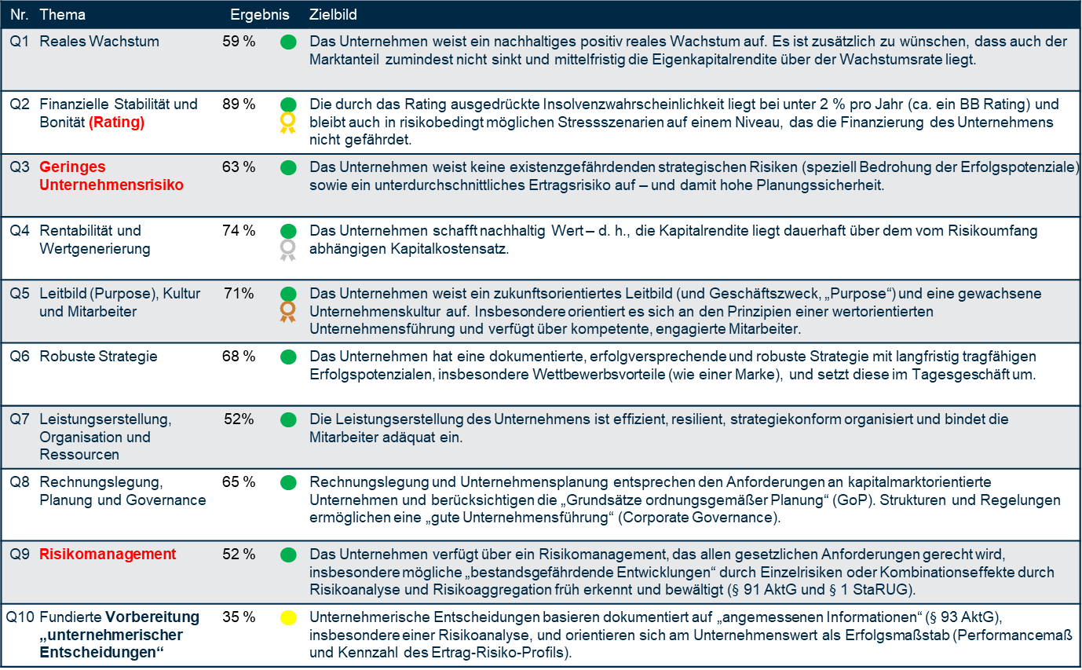
The criteria for future viability (QScore) &
... and the importance of planning & risk
 | Criterion for future viability
■ | Fulfilled |  | Gold
■ | Not fulfilled |  | Silver
■ | Critical level |  | Bronze
No.​ | Topic​ | Result​ |  | Vision​
Q1​ | Real Growth​ | 59 %​ | ■ | The company shows sustainably positive real growth. It is also desirable that market share does not decline and that, in the medium term, the return on equity exceeds the growth rate.​
Q2​ | Financial Stability and Credit Rating | 89 %​ | ■ | The credit rating, based on an estimated probability of insolvency, is below 2% per year (approximately equal to a BB rating) and remains at a level where even stress scenarios pose no threat to financing. The company is not at risk. ​
Q3​ | Low Business Risk​ | 63 %​ | ■ | The company has no existential strategic risks (e.g., special threats to profit potential) and only a below-average return risk – thereby ensuring planning reliability.​
Q4​ | Profitability and Value Creation​ | 74 %​ | ■ | The company creates sustainable value – i.e., return on capital is consistently above the capital costs adjusted for risk.
Q5​ | Guiding Principle (Purpose), Culture, and Employees | 71 %​ | ■ | The company has a forward-looking guiding principle (and business purpose, “purpose”) and a strong corporate culture. It is clearly aligned with value-based corporate leadership and has competent, engaged employees. ​
Q6​ | Robust Strategy​ | 68 % | ■ | The company has a documented, forward-looking, and robust strategy with long-term profit potential, distinct competitive advantages (like a brand), and integrates it into daily operations.
Q7​ | Service Delivery, Organi-zation, and Resources​ | 52 %​ | ■ | The company delivers its services efficiently, resiliently, is strategically well organized, and appropriately engages its employees.​
Q8​ | Accounting, Planning, and Governance ​ | 65 %​ | ■ | Accounting and planning meet the requirements of capital market-oriented companies and follow the “principles of orderly planning” (GoP). There is a functioning governance structure. ​
Q9​ | Risk Management​ | 52 %​ | ■ | The company has a functioning risk management system that identifies risks early, evaluates them, and develops countermeasures. It is properly documented and functional (§91 AktG and IDW PS 981). ​
Q10​ | Well-founded Decision-making | 35 %​ | ■ | Business decisions are based on documented and appropriate information (§93 AktG), including a risk analysis, taking into account the company’s performance metrics (e.g., profit and risk profile).​
Source: Gleißner / Weissman, Das zukunftsfähige Familienunternehmen, 2024

Slide 4
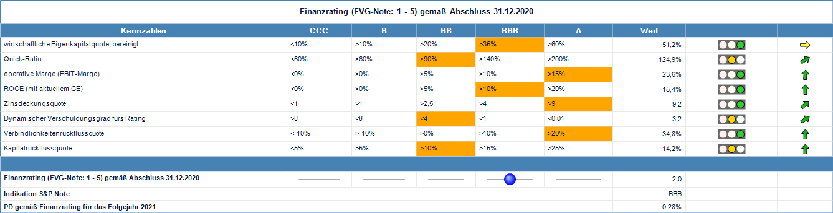
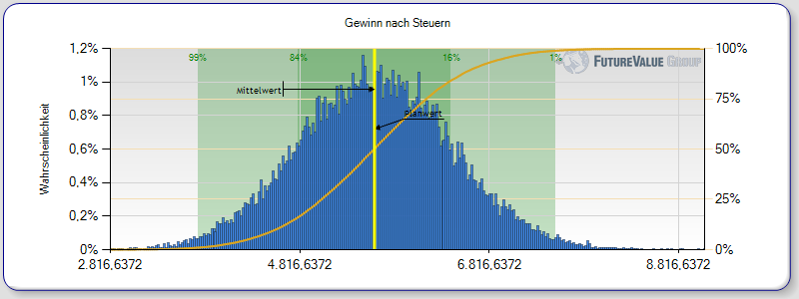
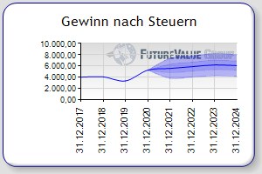
Q1 ... Q4: "financial sustainability"—calculation requires risk analysis and risk aggregation Example evaluation based on public information
No. | Topic | Result | Explanations and potential for improvement
Q1 | Real growth | 63 % | Positive real, but only slightly above-average growth (especially in the cloud segment). No significant increase in market share.
Q2 | Financial stability and creditworthiness | 93 % | A Rating (probability of insolvency max. p = 0.3 %)
Q3 | Low corporate risk | 92 % | High planning reliability / low earnings uncertainty (coefficient of variation of profit = 13.6 %)
Q4 | Profitability and value genera-tion (return > cost of capital) | 80 % | High return on capital, far higher than the risk-dependent cost of capital (positive value spread)
Growth
w > 0
Earnings risk
< x₁
3,2 %
13,6 %
Q
financially sustainable
The company
"Quality company"
< 0,3 %
16,2 % > 6,0 %
Probability of insolvency
< x₂
Return
> Cost of capital
2021
Risk to going concern 2021: PD according to financial rating | 0.3 % | Indicative Rating
Risk to going concern 2021: PD according to simulation | 0.1 % | A
Probability of endangerment 2021: Failure to meet the minimum rating B– | < 1.0 %

Slide 5
Financial sustainability: measurement and empirical evidence
Abstract
.....Wir suggest measuring the financial sustainability of a company on the basis of four conditions:
(1) company growth, (2) the company's ability to survive, (3) an acceptable overall level of earnings risk and (4) an attractive earnings risk profile.
We show that applying a condition-based investment strategy to European companies with high financial sustainability (i.e. companies that fulfill all four conditions) leads to a monthly excess return of 0.39% over the period from July 1990 to June 2019. The risk of this portfolio is lower than the risk of market investments. We find that excess returns increase as each of the four conditions is gradually incorporated into the investment strategy.
Figure 1: Indexed performance of the SCORE 4 portfolio compared to the market
Performance,
Source: Gleißner, W./Günther, Th./Walkshäusl, Ch. (2022): ​
‘Financial sustainability: measurement and empirical evidence, in: Journal of Business Economics, 92, pp. 467–516, https://doi.org/10.1007/s11573-022-01081-0.

Slide 6
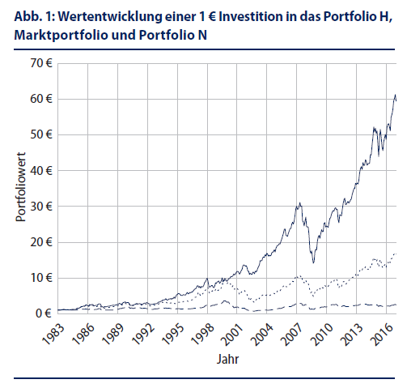
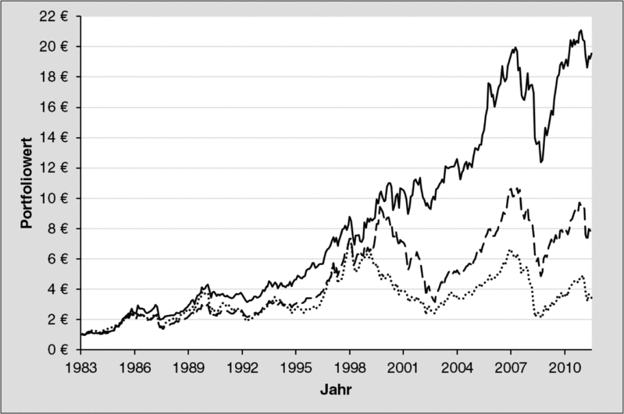
Low fundamental risks and a good risk/return profile lead to better performance: use risk-adequate management!
Performance of a € 1 investment in three different portfolios over the
the observation period 1983 to 2011 (left) and 2017 (right).
- Portfolio with low fundamental risks,
- CDAX
--- Portfolio with high fundamental risks
Fig. 1: Performance of a €1 investment in Portfolio H, the market portfolio, and Portfolio N
  Source left: Walkshäusl, C. (2013): Fundamentalrisiken und Aktienrenditen – Auch hier gilt, mit weniger Risiko zu einer besseren Performance, in: Corporate Fiance biz 3/2013, pp. 119-123. ​
  Source right: Gleißner, W./Walkshäusl, C. (2018): Erfolgreiche Value-Anlagestrategien durch risiko- und ratinggerechte Unternehmensbewertung – Ertragsrisiken, Rating, Kapitalkosten und Aktienrenditen, in: Corporate Finance, No 05-06/2018, pp. 161-171. ​

Slide 7
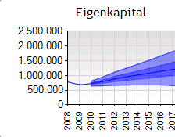
The future always means uncertainty
Risk as a possible deviation from the plan (opportunity & threat)
€
Positive
Deviation
€
Opportunities
Opportunities
Reality: also positive target deviation
Reality: also positive target deviation
The future
Annual result
Planned value /
target value
The future
expected
KonTraG
KonTraG
only negative target deviation
only negative target deviation
Negative
Deviation
Dangers
Dangers / Threats / Probability
Equity
Residuum
plus.
Scope of risk
  ... and risk makes decisions difficult!

Slide 8


Business decisions as a balancing of risk and return in Germany
StaRUG/KonTraG
Risk appetite (A)
Risk tolerance
Risk-bearing capacity
Risk appetite (B)
Expected
Yield / return
Business Judgement Rule
rising value!
Key figures on the risk situation:
The risk-bearing capacity value:
What is the maximum loss (affecting liquidity) that can be absorbed until a "development jeopardizing the existence" occurs?
The probability of a crisis (probability of risk-bearing capacity):
What is the probability that the totality of risks will result in a "development that jeopardizes the company's continued existence"?
Note: A Monte Carlo simulation is required for risk aggregation - e.g. with the free "FVG Strategie-Navigator": Download at: http://strategienavigator.net/software
Do not
invest
Risk
 | Status quo |  | Including Measure
 | Distance | Probability of Breach | Distance | Probability of Breach
Risk-bearing capacity | €500 million | 1 % | €350 million | 2.5 %
Risk tolerance | €80 million | 8 % | €40 million | 10%

Slide 9
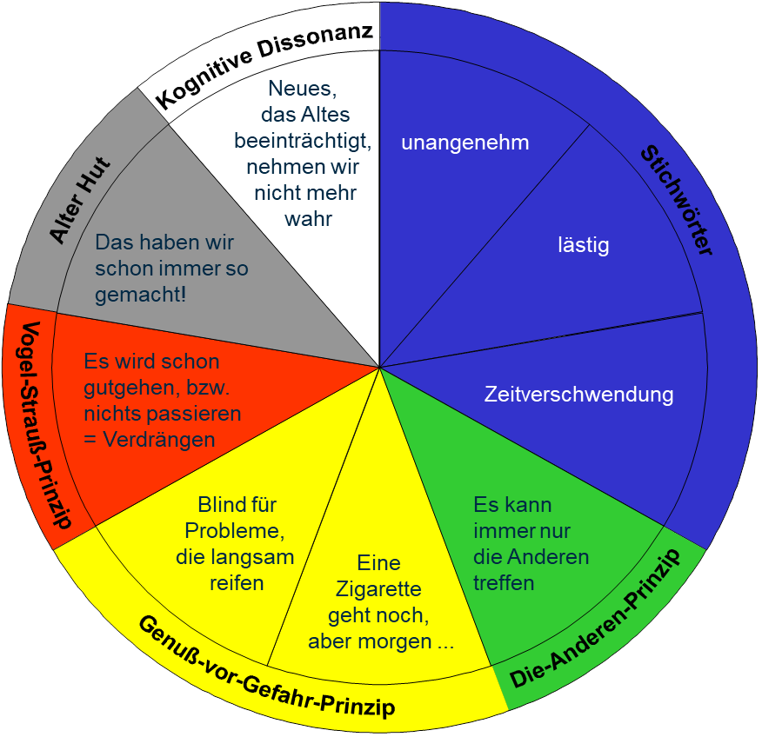
The problem of risk blindness: people don't like to deal with risks!
Risks are suppressed. We love (illusory) security.
The distorted perception of risk:
(1) striking, often repeated but
insignificant risks trigger fear and
(2) important but abstract risks
are ignored.
Risks are not adequately factored into decisions.
Source: Gleißner, W. (2022): Grundlagen des Risikomanagements, 4th ed., Vahlen Verlag Munich, p. 67.

Slide 10
Structured risk analysis: 5 risk categories
Operational performance risks
Planning risks and financial risks
Threat to the potential for success
Risks from the industry environment
Uncertain trends / macroeconomic crises
Source: Gleißner, W. (2022): Grundlagen des Risikomanagements, 4th ed., Vahlen Verlag Munich, p. 124.​

Slide 11
The future and planning are uncertain:
What opportunities and risks lead to deviations from the plan?
Strategic risks
Risks
Success potentials and their threats
Uncertain planning assumptions
Controlling, planning, budgeting
Other risk areas
Identification by means of workshops
1st filter: Setting priorities
Determine risk priorities in the risk areas
(Basis: expert assessment, financial data, historical analysis)
2nd filter: Rough estimate of relevance
Focused risk identification (with relevance assessment)
(Basis: expert assessment, financial data, historical analysis)
3rd filter: Risk inventory
Detailed analysis of the most important risks (quantification)
- Determination of scenarios and distribution functions
- Detailed justifications and cause-and-effect relationships

Slide 12
Risk areas (a structural proposal by FutureValue Group AG)
Source: Gleißner, W. (2022): Grundlagen des Risikomanagements, 4th ed., Vahlen Verlag Munich, pp. 148-149.​

Slide 13
Checklist: The 30 most important business risks
1. threat to (core) competencies or competitive advantages (e.g. pricing power through brands).
2. management risks (e.g. wrong decisions from the owners' point of view due to (a) personal interests of the company management or (b) inadequate method of decision preparation).
3. cyclical fluctuations in demand (fluctuations in sales volumes; economic crisis).
4. sales price fluctuations.
5. structural risks of the markets due to unfavorable structure of competitive forces, e.g.
- limited opportunities for differentiation in stagnating markets,
- low barriers to market entry or
- considerable risk of substitution.
6. market entry of new competitors.
7. strong dependencies on a few customers or a few suppliers (or risky countries).
8. possible failure of important projects (e.g. R&D, investments).
9. procurement risks (price, quality, availability).
10. currency risks (relating to current transactions, receivables or liabilities and/or the competitive position).
Source: Gleißner, W. (2022): Grundlagen des Risikomanagements, 4th ed., Vahlen Verlag Munich, pp. 207-208.​
Notes:
13

Slide 14
Checklist: The 30 most important business risks
11. interest rate and inflation risk.
12. counterparty default risks, in particular customer insolvency.
13. impairment risks and fluctuations in the value of investments or securities.
14. risks from the use of derivatives.
15. organizational risks due to missing or unclear task and competence regulations.
16. risks due to the loss of key personnel.
17. liability claims or product liability cases.
18. impairment of the ability to deliver due to the failure of central production components (e.g. machine damage).
19. damage to property, e.g. as a result of fire (not insured).
20. personnel cost risks.
Source: Gleißner, W. (2022): Grundlagen des Risikomanagements, 4th ed., Vahlen Verlag Munich, pp. 207-208.​
Notes:
14

Slide 15
Checklist: The 30 most important business risks
21. calculation risks, in particular for long-term contracts and in the project business ("project risk").
22. risks due to insufficient early information (e.g. regarding technological trends or competitors' activities).
23. IT failure, data loss and cyber risks.
24. infidelity, fraud.
25. pension provision risk.
26. refinancing risk (bond or large loan or covenants) or financing risk.
27. possible violations of laws and regulations (legal and compliance risks), e.g. weaknesses in the internal control system.
28. risks due to changes in legislation (including tax law) or unclear interpretation of laws ("regulatory risks").
29. sustainability risks (e.g. due to CO2 emissions).
30. fluctuations in the value of inventories.
Source: Gleißner, W. (2022): Grundlagen des Risikomanagements, 4th ed., Vahlen Verlag Munich, pp. 207-208.​
Notes:
15

Slide 16
A simple measure of risk: rough estimate of relevance
Relevance Scale
Base Value | Usual Operating Result
Relevance | in % | Description
1 | 0 % to 5 % | Insignificant risk, causing barely noticeable deviations from the operating result.
2 | 5 % to 30 % | Moderate risk, causing a noticeable positive or negative impact on the operating result.
3 | 30 % to 100 % | Significant risk that strongly influences the operating result, either positively or negatively.
4 | 100 % to 400 % | Severe risks that could more than double the operating result in a positive case but could lead to an annual loss or significant reduction in a negative case—negative view dominates.
5 | > 400 % | Risks that could, with significant probability, more than quadruple the operating result in a positive case, but in a negative case, threaten the company’s continued existence—negative view dominates.
Relevance is therefore an expression of the overall significance of the risk for the company and serves as a filter for prioritizing risks.
Notes:
16
23/10/2025

Slide 17

Necessity of risk quantification
Risk quantification: Description of the stochastic construct "risk" (opportunity and/or hazard) in terms of frequency of occurrence and uncertain effects (over time)
Why is it necessary to quantify risks and express them in figures?
Because risk information is ultimately used to derive conclusions for variables expressed in figures, e.g.
Probability of insolvency and
risk-adequate debt capital interest rates
Equity and liquidity requirements
Cost of capital and enterprise value (or project value contribution)
Maximum acceptable costs for risk management measures
(e.g. insurance premiums).

Slide 18
Risk quantification: Description of risks using probability distributions
1
Determination of risk information for relevant risks:
Evaluation of historical data (e.g. variance analyses)
And/or in the form of expert assessments (as part of interviews or workshops)
2
Risk quantification based on the risk information determined
Not quantifying a risk at all means quantifying the risk as 0
Options for quantifying risks (examples):
Mean = 1.33
- 3 σ
+ 3 σ
(18 out of 30=)
60%
99,7%
VaR
(9 out of 30 =)
30%
- σ
+ σ
(3 of 30 =)10%
68,3%
0,00
0,75
1,50
2,25
3,00
a)
Triangular distribution
b)
Scenario distribution
c)
Normal distribution
Suitable for e.g. volume fluctuations in sales
Allows simple estimation of maximum, minimum and most probable value
Suitable for e.g. machine damage
Historical data is used to indicate in how many cases the damage has reached certain values (e.g. low damage in 60% of cases)
Suitable for e.g. planning risk (many small individual risks that are independent of each other)
Describes risk through an expected value and its standard deviation

Slide 19
Principles of risk quantification
Choice of probability
distribution
1
Select a suitable probability distribution for each risk
(e.g. normal distribution or triangular distribution). Combinations of distributions
of distributions
Documentation
2
Justify and document the derivation and data basis of the risk quantification
Principles of risk quantification
Quantification
of the risks
3
Net risks are quantified, i.e. the "residual risk" taking into account the risk management
measures taken
Recording of
changes/fluctuations
Only unplanned and unpredictable changes/fluctuations are included in the
Risk quantification (deviations from the expected value)
4
The best available information is used for risk quantification, which also
can be "subjective expert estimates" (whose "estimation certainty" can be determined
—meta-risk)
Integration of information
5
Source: Gleißner, W. (2022): Grundlagen des Risikomanagements, 4th ed., Vahlen Verlag Munich, pp. 227.​

Slide 20
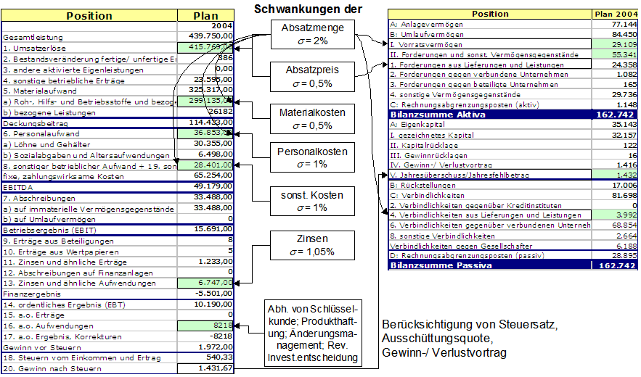
From strategy to operational planning and risk analysis to risk aggregation —example "Strategy Navigator" (FutureValue Group AG)
To Do: Assess the monetary consequences of strategic measures and analyze risks that could cause deviations from the plan!

Slide 21
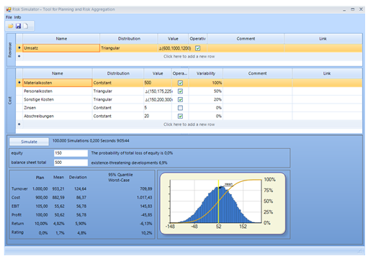
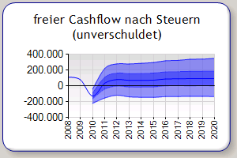
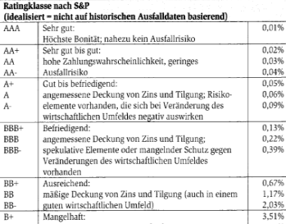
Risk aggregation (using Monte Carlo simulation): Bandwidth planning and necessity to identify a severe crisis from the combined effects of individual risks
Target level (here 1%) is rating-dependent.
Plan G&V
DVaR_{1%}
5,000 Trials
EKB
17 Outliers
,034
170
,026
127,5
,017
EK
85
,009
42,5
,000
0
-200,00
-100,00
0
56,00
100,00
200,00
250,00
Estimation of the probability of default (PD)
In what % of the simulated future scenarios does
(1) over-indebtedness or
(2) illiquidity occur?
Assignment of a rating grade possible!

Slide 22
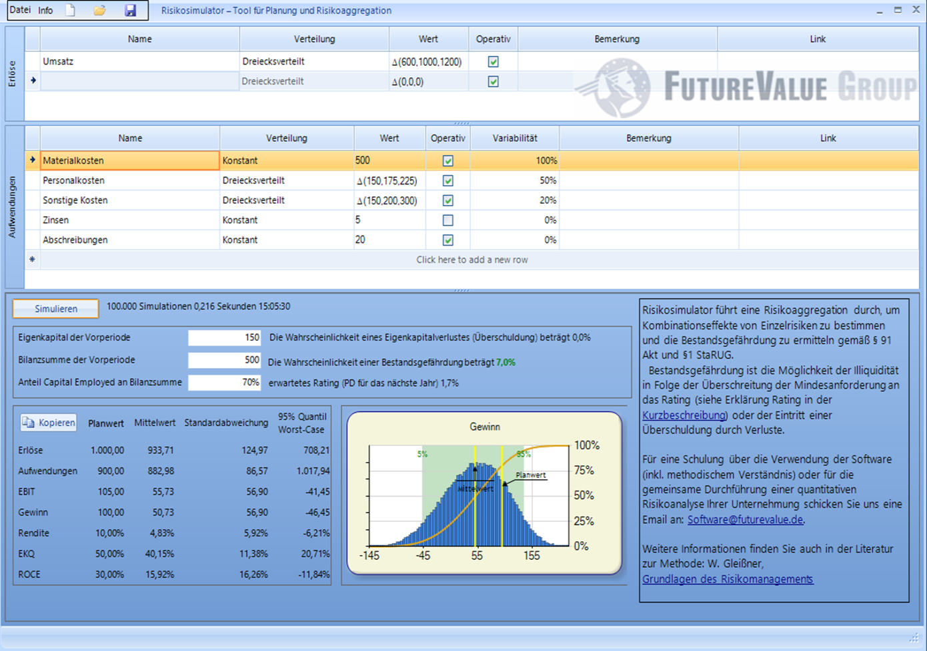
The FVG risk simulator for risk aggregation (see Section 1 StaRUG)
Download at: http://strategienavigator.net/software
Free software for simple and fast risk aggregation as an introduction to decision support under uncertainty

Slide 23
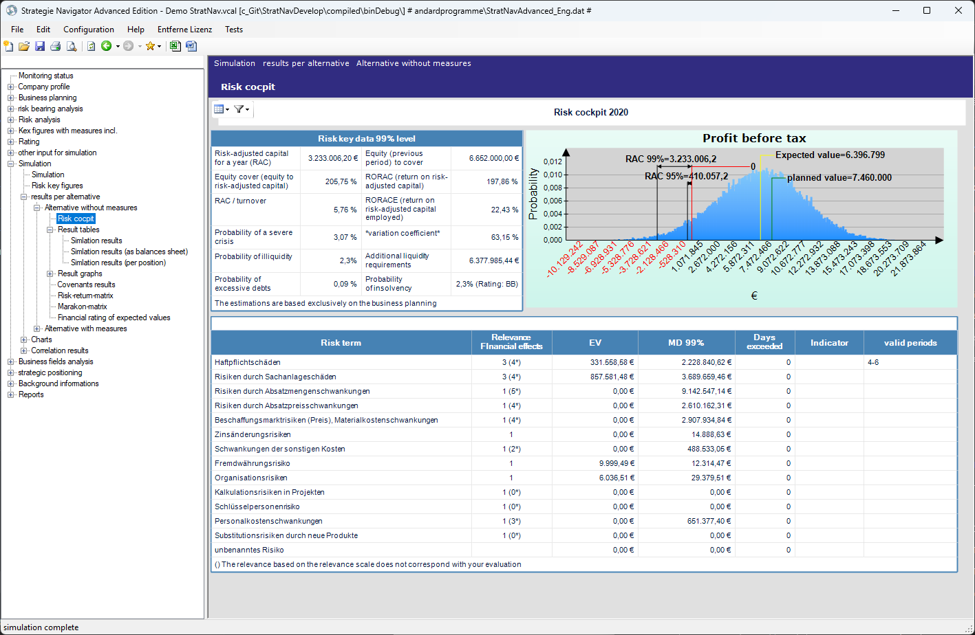
The FVG “Strategie-Navigator“
Download at: http://strategienavigator.net/software

Slide 24
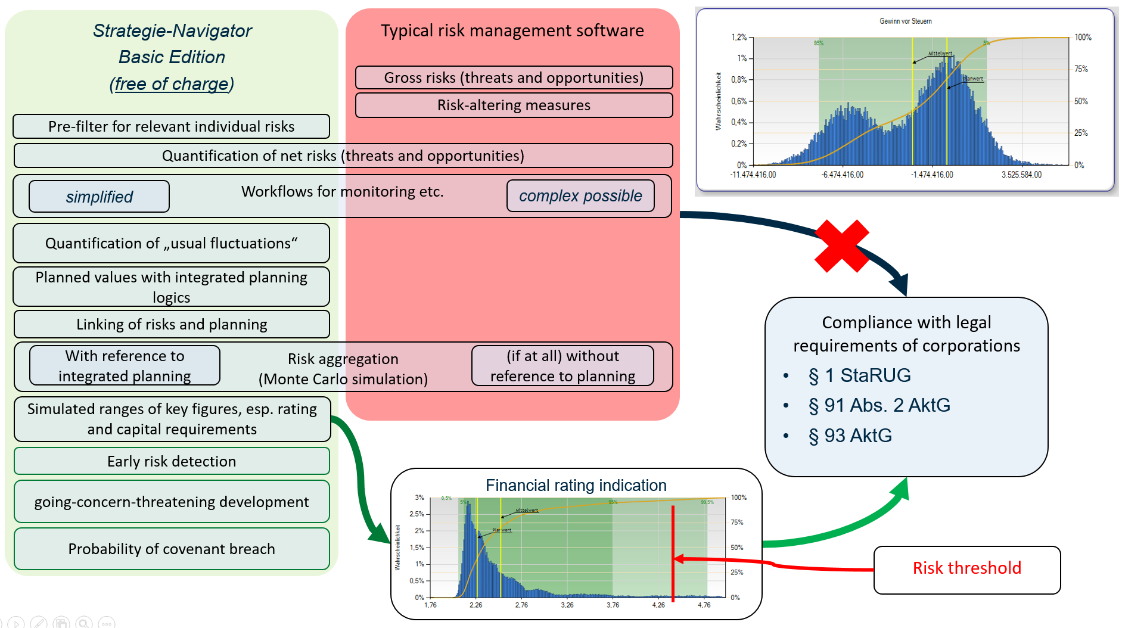
The FVG “Strategie-Navigator“

Slide 25
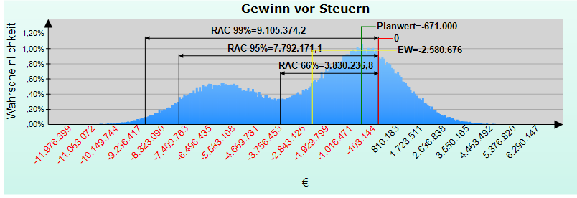
Overall scope of risk: risk aggregation with Monte Carlo simulation in the context of planning (sample results)
Earnings before taxes (EBT)
Risk metrics at the 95% confidence level
Equity requirement for one year (RAC) | €7,792,171.10 | Economic capital (previous period) for coverage | €13,256,000.000
Equity coverage (equity in relation to equity requirement) | 170.12% | RoRAC (Return on Risk-Adjusted Capital) | -33.12%
RAC/Total Output | 13.64% | Coefficient of variation | -118.01%
Probability of illiquidity | 0.0% | Additional liquidity requirement | 0.00€
Probability of over-indebtedness | 0.0% | Probability of insolvency | 0.0% (Rating AA)
These estimates are based solely on the company’s planning.
Degree of threat to the company as a going concern and early detection of "developments jeopardizing the company as a going concern" in accordance with Section 91 AktG (from the combined effects of individual risks)
The probability of insolvency (derived from the simulation) broken down into illiquidity and overindebtedness
Distribution of profits, mean value, quantiles
Equity requirement and equity cover
Additional liquidity requirements
Coefficient of variation of profits

Slide 26
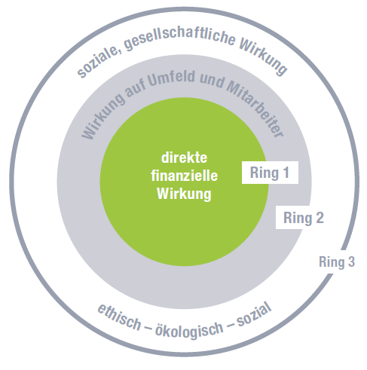
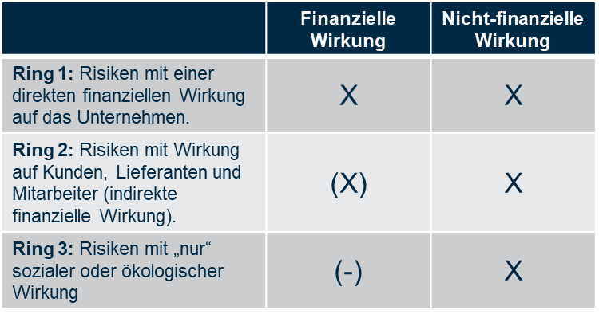
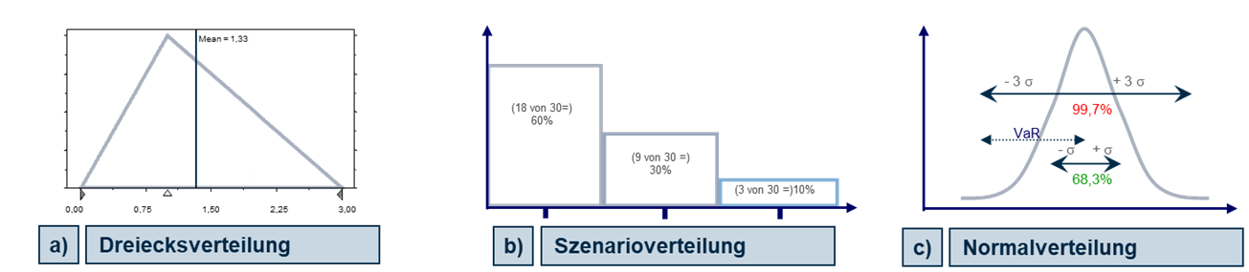
Special aspect: "Sustainability risks" (ESG risks) are risks that also (!) have non-financial effects!
Non-financial metrics required, e.g. DALY, CO₂ emissions (in tons), ...
Costs due to permissible emissions (e.g. CO₂)
Damage due to unacceptable effects on the environment or third parties (e.g. damage payments for environmental pollution)
Financial impact as a result of (perceived) negative effects of the company's activities on (a) the environment or (b) society (reputational risks with loss of sales)
Attention: Consider sustainability risks in risk aggregation (§1 StaRUG)
The free FVG risk simulator; download at: http://strategienavigator.net/software
Source: ​Gleißner, W. (2019): Nachhaltigkeit, CSR-Risiken und Risikomanagement. Vom CSR-Risiko zum finanziellen Risiko, in: Controller Magazin, No 4, 2019, pp. 95 and Gleißner, W. (2022): Grundlagen des Risikomanagements, 4th ed., Verlag Franz Vahlen, Munich 2022​.

Slide 27
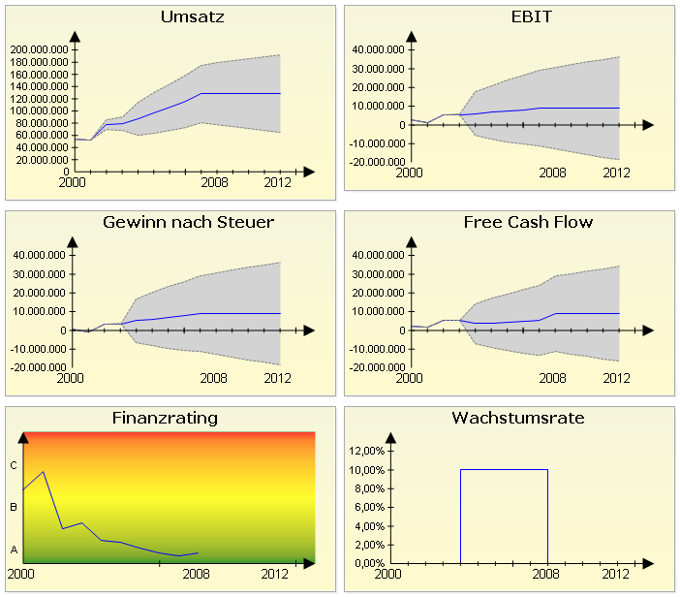
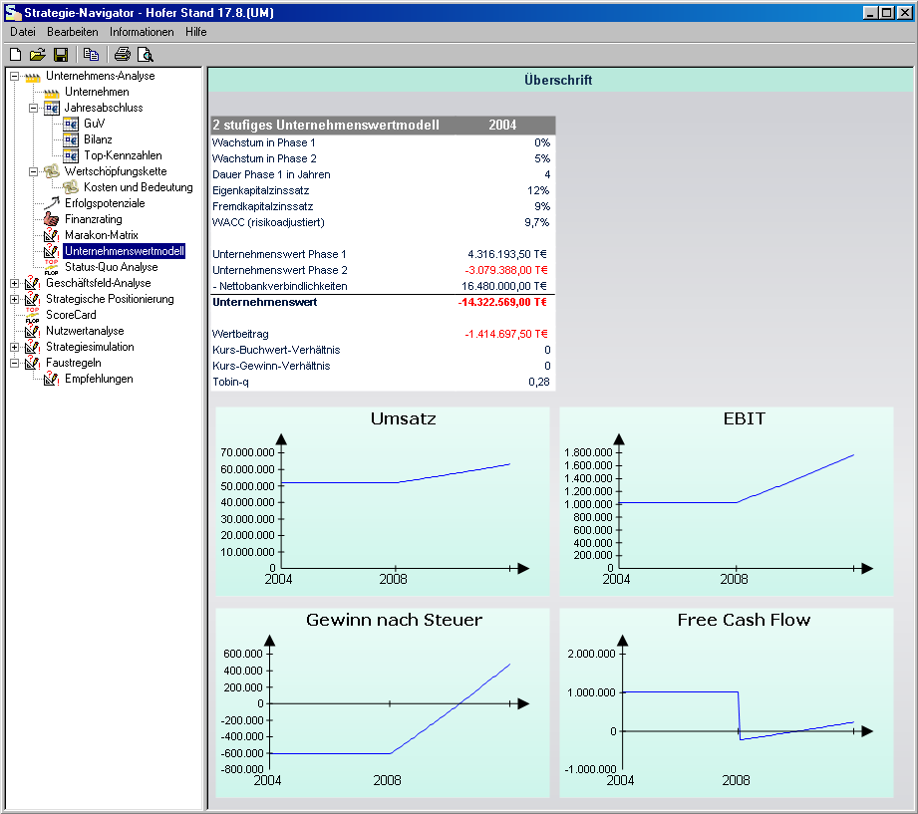
Bandwidth planning and simulation-based company valuation based on earnings risk and insolvency risk (Strategie-Navigator, http://strategienavigator.net/software)
"Terminal value", i.e. DCF of the extrapolation period t >T
Exemplary representation
Valuation of covenants:
Probability of injury
Expected loss

Slide 28
The concrete alternative courses of action developed are visualized in the Risk Optimization Matrix
Strategic risks
Market risks
Financial risks
Legal risks
Performance risks
Exit from business segment
Avoid derivatives
Outsourcing
Avoid
Expand core competencies
New business areas
Optimize contracts
Design machines redundantly
diminish
limit
Interest rate cap
Define revision processes
Hedging commodity prices
Currency swap
Liability insurance
Business integration insurances
transfer
carry yourself
(equity)
Increase equity
Develop rating strategies

Slide 29
Managing strategic risks and "robust companies"
Mission statement
Securing the future for companies
The development and implementation of a risk-conscious corporate strategy
Valuable and versatile core competencies in the long term
Diversification and loss limitation
Competitive advantages:
  Differentiation from competitors
  Long-term customer loyalty
Robust
Corporate
strategy
Optimization of the value chain
Uncomplicated, stable and flexible workflows
Redundancies and conditions for self-organizing structures
Flexibility, agility and organizational resilience
Adaptability to unforeseen developments (e.g. through reserves)
Reduction of dependencies (e.g. through redundancies)
Sufficient risk coverage potential (for passive hedging)
Source: Gleißner, W. (2023): Uncertainty and resilience in strategic management: profile of a robust company, in: International Journal of Risk Assessment and Management, Vol. 26, No 1, pp. 75–94.​

Slide 30
Organization of the risk management system
Management Board
Supervisory Board
Reporting channel
Reporting channel
Central
Risk controlling
Management Board / GL
Subsidiary company
Reporting channel
Central function
Manager = Risk Owner
Decentralized
Risk controlling
Risk Owner
Reporting channel

Slide 31
Traditional risk management processes
4. monitoring: monitoring and reporting
Continuous monitoring of risks
Recording, evaluating and forwarding
new information: Transparency about
individual risks
1. risk analysis status quo
Risk identification
Risk quantification
Risk measures and risk value
contribution (prioritization)
3. implement risk management measures (RBM)
Ideas for RBM
Valuation of RBM (value
contribution)
Implementation of the RBM
2. risk aggregation status quo
Calculation of total risk exposure
(capital requirement)
Rating forecast for base and stress
stress scenarios
Risk-adjusted cost of capital as
return requirements

Slide 32
Process in the integrated, decision-oriented risk management system
Analyzes from
Strategy
Production
Marketing/Sales
Controlling
Measure with effect
on the risk/return profile:
YES
Planning
of the measure
NO
Risk analysis
Status quo plus measure
Monitoring
Monitoring, reporting
Risk analysis
Status quo
Risk aggregation
Status quo plus measure
Risk management
measures
Risk aggregation
Status quo
Risk-appropriate valuation
of the measure
Decision to pass
implementation of the measure:
Implementation
of the measure
NO
Cf. Gleißner, W. (2020): Integratives Risikomanagement. Schnittstellen zu Controlling, Compliance und Interner Revision, in: Controlling, 32. Vol., No 4, pp. 23–29; Gleißner, W. (2018): Risikomanagement 20 Jahre nach KonTraG: Auf dem Weg zum entscheidungsorientierten Risikomanagement, in: Der Betrieb, No 46, pp. 2769-2774 and Gleißner, W. / Berger, Th. (2024): Enterprise Risk Management: Improving Embedded Risk Management and Risk Governance, in: Risks, Vol. 12, No 12, 05.12.2024.
YES

Slide 33
10 criteria for analyzing the risk management of ...
 | Early crisis detection (§ Section 91 (2), (3) AktG and Section 1 German StaRUG ) | Points
1 | There is a documented and explained risk management system (Section 91 (3) AktG) whose organization and processes appear appropriate and effective (in particular for identifying, analyzing and monitoring risks).
2 | Risk aggregation is available and is carried out using an appropriate method (Monte Carlo simulation) and with reference to corporate planning.
3 | All material net risks (threats and opportunities) are analyzed, including those that only or primarily have an impact on liquidity or the balance sheet (risks are not only considered in terms of their impact on earnings).
4 | The risk management system considers rare but relevant "extreme risks" with potential effects that could jeopardize the company as a going concern (e.g. possible economic crises).
5 | Risk quantification is carried out appropriately, i.e. suitable distribution functions are used (and risk quantification is not based solely on probability of occurrence and (expected) loss amount).
6 | The term "going concern risk" is properly operationalized (taking into account, for example, possible threats to ratings and covenants) and there is a key figure for the "degree of going concern risk".
7 | There is a threshold value for the key figures on the threat to the company's existence, above which (1) "suitable countermeasures" are initiated and (2) the supervisory body is informed (Section 1 German StaRUG).
 |  | 0 | from 14 points
 | Preparation of decisions / business judgment rule (§ Section 93 German AktG)
8 | There are regulations and processes in place to provide and document verifiably appropriate information for "entrepreneurial decisions" by the management, e.g. the risks associated with the decisions.
9 | The decision templates contain neutral and quantitative risk information, the effect of the decision on the company's overall risk exposure is calculated and taken into account in the decision calculation.
10 | Easily identifiable risks, e.g. uncertain planning assumptions, are analyzed in the decision documents.
 |  | 0 | from 6 points
 |  |  | from 20 points
Points per statement: 0 "not fulfilled" (or not specified) 1 "partially fulfilled" 2 (almost) "fully fulfilled"

Slide 34
Criteria for level 3 ("regulatory minimum requirements")
 | Level 3: Regulatory Risk Management | Fulfilled | Partly fulfilled | Not fulfilled
1 | Are tasks and responsibilities in risk management clearly assigned?
2 | Are all regulations regarding the identification, quantification, and monitoring of risks appropriate, effective, and clearly documented in a way that is understandable to third parties?
3 | Are appropriate types of probability distributions used for risk quantification (for example, triangular distribution with minimum, most likely, and maximum values for cost growth)?
4 | Are the existing risk mitigation measures taken into account as part of the risk quantification?
5 | Is there a suitable and consistently used risk measure to quantitatively compare and prioritize individual risks?
6 | Is it clearly explained what constitutes a “development that endangers the company’s continued existence” (§ 91 of the German Stock Corporation Act), e.g. violation of covenants?
7 | Is risk aggregation carried out regularly to identify developments that could endanger the company’s existence due to the combination effects of individual risks?
8 | Are the processes for efficient internal risk reporting and risk communication (with reference to appropriate thresholds) clearly defined?
9 | Is there an adequate procedure regarding "ad hoc disclosures" about risks and their impacts?
10 | Are the management board and supervisory board regularly informed about individual risks and the overall risk exposure?
Source: Gleißner, W. (2018): Prüfung des Risikomanagements – ein Reifegradmodell, in: Der Aufsichtsrat, No 2/2018, pp. 18–21.​

Slide 35
Criteria for level 4 ("decision-oriented risk management")
 | Level 4: economic risk management (decision-supporting) | Fulfilled | Partly fulfilled | Not fulfilled
1 | Are opportunities and threats (risks) considered in relation to planned values (risks as a key cause of deviations from the plan)?
2 | Are strategic risks also identified and regularly discussed in corporate management, especially threats to the company’s success potential?
3 | Are existing (management) systems, such as controlling, treasury, or quality management, integrated into the risk analysis?
4 | Is risk aggregation performed over multiple years within the context of integrated corporate planning, meaning that risks are assigned to the positions where they can cause deviations?
5 | Are documented risk analyses conducted to prepare executive board decisions, showing how the scope of risk would change as a result of those decisions (§ 93 German Stock Corporation Act)?
6 | Are the implementation and effectiveness of risk mitigation measures assessed and monitored?
7 | Is a risk policy formulated that is consistent with the company strategy and defines the framework for risk management and risk-oriented corporate governance?
8 | Does the risk manager have the necessary skills, resources, and authority (for example, the right to access information about all potentially risky activities such as planned acquisitions or investments)?
9 | Are the implications of risk analyses evaluated regarding the financing structure (equity requirements) and appropriate debt conditions?
10 | Is risk considered an important factor in strategy development when selecting strategic options (goal: robust strategy)?
Source: Gleißner, W. (2018): Prüfung des Risikomanagements – ein Reifegradmodell, in: Der Aufsichtsrat, No 2/2018, pp. 18 – 21​

Slide 36
Value-based management & valuation of a strategic option
(strategy evaluation: valuation of the risk-return profile)
The value of a payment series is the certain amount of money that is "equivalent" to the (uncertain) payments to be valued ("provides the same benefit").
Therefore: cost of capital from earnings risk, not capital market data (CAPM beta)
 | Status quo | Option for action: foreign expansion
Earnings (EBIT, plan 2025) | 16 | 18,5 | Significant increase in earnings
Risk (coefficient of variation return) | 19% | 21% | Moderately increased risk
Cost of capital (k) | 5,50% | 5,70%
Rating | BB+ | BB+
Rating (stress scenario) | BB | BB- | Stable rating
Value (in € million) | 153 | 168 | Clear increase in value
Strategic fitting |  |  | Competencies available
Source: Gleißner, W. (2015): Controlling und Risikoanalyse bei der Vorbereitung von Top- Management-Entscheidungen – Von der Optimierung der Risikobewältigungsmaßnahmen zur Beurteilung des Ertrag-Risiko-Profils aller Maßnahmen, in: Controller Magazin, No 4/2015, pp. 4–12; Gleißner, W. (2019): Cost of capital and probability of default in value-based risk management, in: Management Research Review (MRR), Vol. 42, No. 11, pp. 1243–1258 and Gleißner, W. / Ernst, D. (2024): Neue Wege der Unternehmensbewertung – Der BGH-Beschluss zur Bestimmung der angemessenen Abfindung und seine Auswirkungen, in: BFuP, No 4, S. 414–431.​

Slide 37
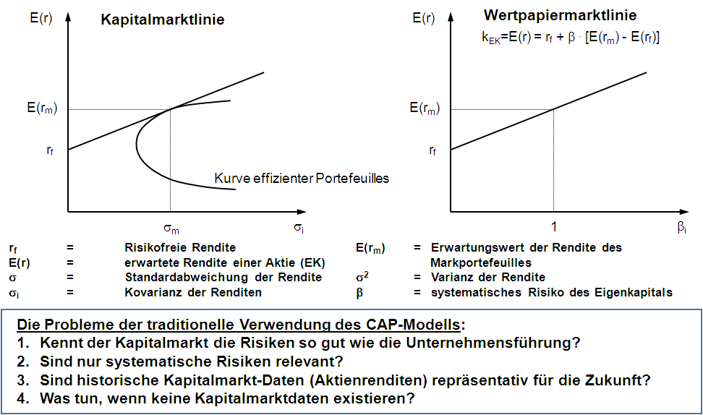
Problems of the CAPM: alternative ways of calculating the cost of capital required
Source: Gleißner, W. (2014): Kapitalmarktorientierte Unternehmensbewertung: Erkenntnisse der empirischen Kapitalmarktforschung und alternative Bewertungsmethoden, in: Corporate Finance, 4/2014, pp. 151–167 und Gleißner, W. (2019): Cost of capital and probability of default in value-based risk management, in: Management Research Review (MRR), Vol. 42, No. 11, pp. 1243–1258.​

Slide 38
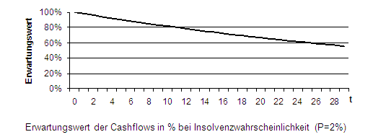
From risk analysis to risk-adequate valuation: effects on the expected value of cash flow, insolvency risk and discount rate
1. earnings risk of the company as a basis
In contrast to the capital market-based models (e.g. CAPM), the expected values and the valuation-relevant risks are determined on the basis of the uncertain income/cash flows to be valued (risk discount) and no recourse to (historical) capital market data is necessary (risk-value model, "imperfect replication").
2. simulation-based valuation approaches
The uncertain payments to be valued are determined on a forward-looking basis using a stochastic planning model for the valuation object by means of Monte Carlo simulation. This makes it possible to link operational planning and all uncertainties.
3. insolvency risk & risk coverage approach (rating restrictions)
The "finiteness" of a company's existence (or the income stream for the owners) due to insolvency (probability, p) must be taken into account. The risk coverage approach also takes existing rating and financing restrictions into account in the valuation.
Cost of capital (c), risk-free rate (r_{f}), Sharpe Ratio (λ), Coefficient of variation of return (V(EBT)), Risk diversification factor (d), Cf. Gleißner, W. (2014): Kapitalmarktorientierte Unternehmensbewertung: Neue Erkenntnisse der empirischen Kapitalmarktforschung und Relevanz einer investitionstheoretischen Bewertung, in: CF, 4/2014, pp. 151-167; Gleißner, W. (2019): Cost of capital and probability of default in value-based risk management, in: MRR, Vol. 42, No. 11, pp. 1243-1258 und Gleißner, W./Follert, F. (2022): Unternehmensbewer-tung im Spannungsfeld zwischen Zweckadäquanz und Praktikabilität. Ein Lösungsansatz für die gerichtliche Abfindungsbemessung, in: BFuP, 74. Vol., No 4, pp. 395-419..​

Slide 39
The value (V) as a performance measure combines expected cashflows (CF) and risks—often via the cost of capital (C) as a risk-adjusted return requirement
(A) Payment series: expected values(!) of the result variable
(B) Risk: risk-adjusted cost of capital
as discounting factor
(C) Rating: Probability of insolvency
as "negative growth rate"
Generation : Derivation of capital costs from historical share return fluctuations (CAPM); neglect of insolvency risks (rating and financing restrictions)
Generation : simulation-based valuation based on planning and risk analysis takes into account earnings and insolvency risks (higher earnings risks lead to higher equity requirements and higher capital costs)

Slide 40
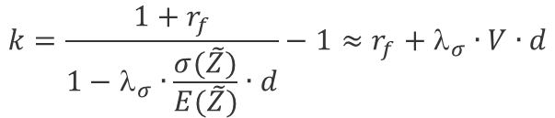

Methodology: How do you capture risks in company valuation? Discount rate from the "earnings risk" according to risk analysis
How do you achieve "risk equivalence"? The problem: From historical stock returns
(β - factor from CAPM) cannot be used in an imperfect capital market to infer the risks of future cash flows (and thus the cost of capital or discount rate) of a company, a strategy, a business unit or a project. But practice wants cost of capital rates (discount rate) for DCF!
Solution approach based on the aggregated risk scope R(Z), i.e. earnings risk
(with probability of insolvency p = 0 or recorded in E(..)):
Valuation possible via (1) risk-adjusted cost of capital k or
(2) risk discount from the expected value of the payment Z
Assumption for deriving the valuation equation using "incomplete replication": Two payments have the same value if they match in (a) time, (b) expected value and (c) risk measure! Here: For alternative investments (a) German government bonds (r_{f} ) and (b) global equity index
(2) Risk discount
from the expected value
(1) Risk-adjusted cost of capital
Source: Gleißner, W.: Die risikogerechte Bewertung alternativer Unternehmensstrategien: ein Fallbeispiel jenseits CAPM, in: Bewertungspraktiker, 3/2013, pp. 82 – 89; Gleißner, W. (2011): Risikoanalyse und Replikation für Unternehmensbewertung und wertorientierte Unternehmenssteuerung, in: WiSt, 7/11, pp. 345 – 352 Gleißner, W. (2019): Cost of capital and probability of default in value-based risk management, in: Management Research Review, Vol. 42, No. 11, pp. 1243-1258 und Dorfleitner, G./Gleißner, W. (2018): Valuing streams of risky cashflows with risk-value models, in: Journal of Risk, Vol. 20, No. 3 (February 2018), pp. 1-27.​

Slide 41
Insolvency risk and expected duration of existence
The primary effect of insolvency risk is that a company does not exist forever. Like insolvency costs, this influences the amount and timing of expected cash flows/income.
Even with an insolvency probability of p > 0, companies can exist indefinitely, i.e. there is no certain point in time at which they will cease to exist.
The probability of insolvency thus leads to a finite expected value of the service life, but not to a limit on the service life.
Of particular relevance to the valuation is the probability p that the cash flow will be interrupted within a year, because the payments to the owners are usually zero anyway in the event of insolvency.
Rating | p (per year) | Expected service life (= 1/p)
A | 0.1 percent | 1000
BBB | 0.5 percent | 200
BB | 1.0 percent | 100
BB- | 2.0 percent | 50
B | 5.0 percent | 20
Source: Gleißner, W. (2010): Unternehmenswert, Rating und Risiko, in: WPg, 14/2010, 63. Vol., pp. 735–743 und Franken, L./Gleißner, W./Schulte, J. (2020): Insolvenzrisiko und Berücksichtigung des Verschuldungsgrads bei der Bewertung von Unternehmen – Stand der Diskussion nach Veröffentlichung des IDW Praxishinweises 2/2018, in: Corporate Finance, No 03-04 vom 30.03.2020, pp. 84-96.​

Slide 42
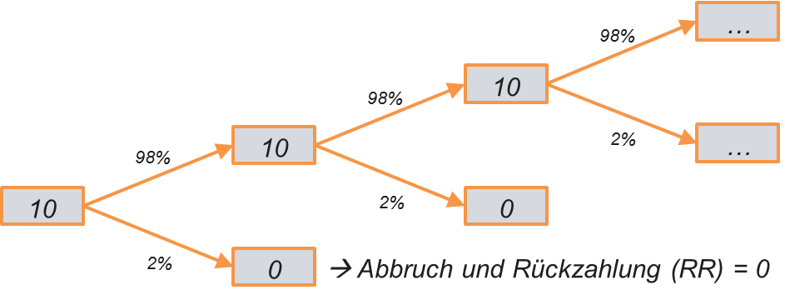
The probability of insolvency must be taken into account in the detailed planning and updating phase
Company-specific (!) insolvency risk must always be considered.
Recording via (1) p surcharge in the usual annuity model (2) binomial tree, which, however, does not allow negative fCf (3) Monte Carlo simulation.
Time (t) | 1 | 2 | 3 | 4 ff.
E(CF) without insolvency (conditional) | 10 | 15 | 20 | 20
Probability of insolvency p_{t} | 0,02 | 0,02 | 0,02 | 0,02
Probability of survival | 0,98 | 0,96 | 0,94 | (1-p)^{t}
Expected value ( ) | 9,8 | 14,4 | 18,8 | 18,4
with a risk-adjusted discount rate of k=10% and a long-term growth rate of w=0%
Gleißner, W. (2017): Das Insolvenzrisiko beeinflusst den Unternehmenswert: Eine Klarstellung in 10 Punkten, in: BewertungsPraktiker, 2/2017, pp. 41-50.; Lobe, S.,/Hölzl, A. (2011): Ewigkeit, Insolvenz und Unternehmensbewertung: Globale Evidenz, in: CFB, No 04, pp. 252-257; Gleißner, W. (2010): Unterneh-menswert, Rating und Risiko, in: Die Wirtschaftsprüfung, 14/2010, 63. Vol., pp. 735–743.; Friedrich, T. (2015): Unternehmensbewertung bei Insolvenzrisiko und Gleißner, W. (2002): Wertorientierte Analyse der Unternehmensplanung auf Basis des Risikomanagements, in: Finanz Betrieb, No 7-8/2002, pp. 417-427.​

Slide 43
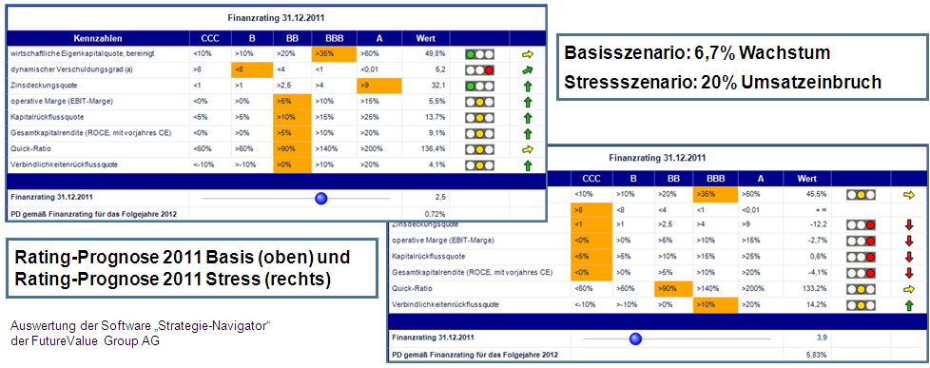
Rating forecast—comparison of base and stress scenario
In the rating forecast, the expected future rating is derived by using the company's financial planning to calculate the key financial ratios that significantly influence the rating.
Financial rating 12/31/2016
Base scenario: 6,7 % growth
Stress scenario: 20 % drop in sales
Financial rating 12/31/2016
Financial rating 12/31/2013
PD according to financial rating
Rating Forecast 2016 Basis (above) and
Rating Forecast 2016 Stress (right)
Financial rating 12/31/2013
PD according to financial rating
In the base scenario, the rating improves by one notch to a BBB rating, while in the stress scenario, a drop to a B rating is observed.

Slide 44
Ten points of clarification on insolvency risk
(which depends on the earnings risk)
In a perfect market without insolvency costs, there is no need to include insolvency risks in the valuation; but there is also no need for company valuations
Insolvency risk leads to deviations between contractual borrowing rates and borrowing costs
The credit spread is usually higher than necessary to compensate for the probability of insolvency (or expected loss)
Insolvency costs reduce the value of the company as a whole (entity value)
The possibility of insolvency must be taken into account when deriving the "expected" plan values
The probability of insolvency must be taken into account in the detailed planning and extrapolation phase and also reduces the value of the tax shield (note: if convergence of return against cost of capital is assumed, this may be "implicit")
Recognizing the insolvency risk in the continuation phase requires (a) a probability of insolvency in the denominator (TV formula) and/or (b) a Monte Carlo simulation.
Even with an option valuation model, the insolvency risk does not lead to an increase in company value
Only insolvency scenarios with restructuring can be value-enhancing
Companies with high levels of debt can expect below-average returns on the stock market
Source: Gleißner, W. (2017): Das Insolvenzrisiko beeinflusst den Unternehmenswert: Eine Klarstellung in 10 Punkten, in: BewertungsPraktiker, No 02, pp. 42-51; Gleißner, W. / Ernst, D. (2019): Company valuation as result of risk analysis: replication approach as an alternative to the CAPM, in: Business Valuation OIV Journal, Vol. 1, No 1, pp. 3–18; Gleißner, W. / Ernst, D. (2023): The Simulation-Based Valuation of Companies and Their Strategies – Classification, Methodology and Case Study, in: EBVM – The European Business Valuation Magazine, Vol. 2, No 2, pp. 4-16.

Slide 45
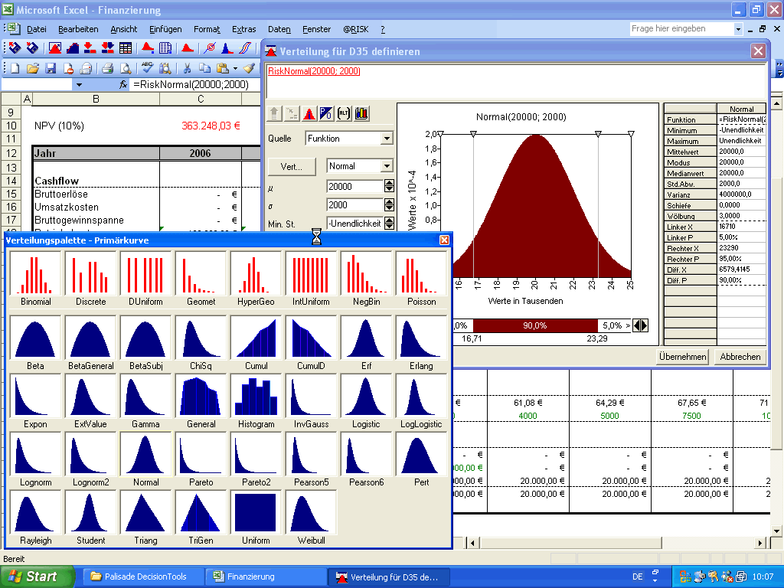
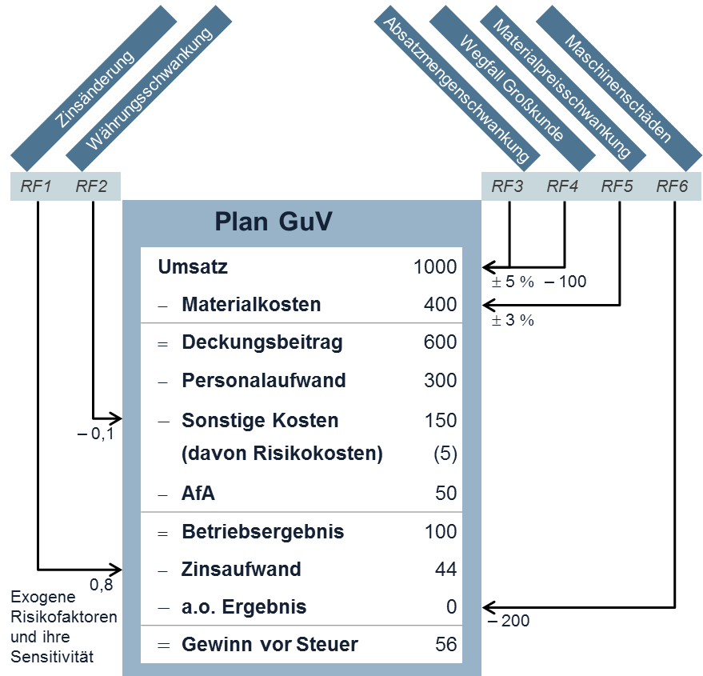
The methods: Risk quantification, risk aggregation & valuation
Target level (here 1%) is rating-dependent.
5,000 Trials
DVaR_{1%}
EKB
Risk
aggregation
,034
170
,026
127,5
,017
EK
85
,009
42,5
,000
0
-200
-100
0
56
100
200
250
Europe (1981-2016) | Time (years)
Rating | 1 | 2 | 3 | 4 | 5 | 6 | 7
AAA | 0 | 0 | 0 | 0 | 0 | 0 | 0
AA | 0 | 0,03 | 0,07 | 0,14 | 0,21 | 0,29 | 0,33
A | 0,04 | 0,08 | 0,13 | 0,19 | 0,29 | 0,39 | 0,51
BBB | 0,08 | 0,23 | 0,39 | 0,54 | 0,65 | 0,9 | 1,13
BB | 0,41 | 1,38 | 2,35 | 3,06 | 4,2 | 5,15 | 6,11
B | 2,53 | 6,21 | 9,37 | 11,86 | 13,86 | 15,26 | 16,06
CCC/C | 26,38 | 35,4 | 40,64 | 45,64 | 48,01 | 48,01 | 49,05
Investment grade | 0,04 | 0,12 | 0,19 | 0,28 | 0,38 | 0,5 | 0,63
Speculative Grade | 2,73 | 5,4 | 7,59 | 9,28 | 10,84 | 11,94 | 12,83
All ratings | 0,67 | 1,3 | 1,8 | 2,19 | 2,54 | 2,83 | 3,08
Equity = equity capital
EKB = equity capital requirement
Estimation of the probability of default (PD)
In what percentage of the simulated future scenarios does
(1) over-indebtedness or
(2) illiquidity occur?
Assignment of a rating grade possible!
Amount of risk and cost of capital
Expected profit
Transformation of p in the rating
Enterprise value
*Mock, T. (2017): Auf was Bewerter beim Rating achten sollten!, Presentation during EACVA‘s 11th Annual Conference 2017, p. 14.​

Slide 46
Capital market orientation vs. value orientation
"Common understanding" of capital market orientation
Value orientation
Primary goal
Increase in the share price
Increase in the fundamental value of the company
Target group
Currently committed (short-term) investor
Investor committed to the long term
Information relevance of the capital market
Use of capital market data (e.g. beta factor) for business decisions
Use of even superior internal company information for business decisions
Focus on information policy
Creation of (advantageous) transparency and reputation (IR)
Severe restriction of IR
("information relevant to competition")
Credo
Capital market (stock market) is always right
Stock market prices may deviate temporarily from the fundamental value due to capital market inefficiencies.
Source: Gleißner, W. (2009): Kapitalmarktorientierung statt Wertorientierung: Volkswirtschaftliche Konsequenzen von Fehlern bei Unternehmens- und Risikobewertungen, in: WSI Mitteilungen, 6/2009, pp. 310 -318.​

Slide 47
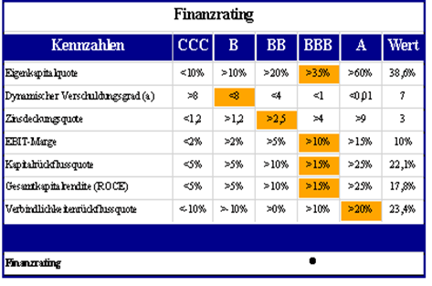
Risk reporting: the core content
Equity coverage as a threat indicator
The ratio of the available equity to the equity requirement (from risk aggregation) (e.g. on a three-year view for a BBB rating, for example):
Planning reliability
The coefficient of variation of earnings (or EBIT) shows the relative range of fluctuation and therefore the extent of possible deviations from the plan
Risk-adjusted cost of capital
Risk-adjusted cost of capital (based on earnings risk V) converts risk into required return ("value-based management")
Rating and threat to target rating, minimum rating or covenants
Probability of insolvency (p) as a measure of "portfolio threat"

Slide 48

The three levels of sustainability
Activities are sustainable if they do not impair the satisfaction of the needs of people in the future.¹
Sustainable companies must
contribute to the satisfaction of needs (of their customers)
perform,
their own existence as a prerequisite for this permanently
secure (financial sustainability) and
no unreasonable damage as a secondary condition
for third parties, especially not for the company
and the environment (at least to the extent that this satisfies the
future people).
Financial sustainability is a fundamental prerequisite for sustainable corporate governance and a key parameter within the ESG concept of "G" (governance).
of "G" (governance).
Avoidance of
damage with
(or benefit for)
Need
Satisfaction
Financial
Sustainability
the customers
Society and environment
1 See Brundtland Commission (1987): Report of the World Commission on Environment and Development: Our Common Future, United Nations, http://www.un-documents.net/our-common-future.pdf, accessed 11.03.2022).​
Source: Gleißner, W./Günther, Th./Walkshäusl, Ch. (2022): Financial sustainability: measurement and empirical evidence, in: Journal of Business Economics, Vol. 92, No. 3, pp. 467–516; Gleißner, W. (2023): Nachhaltigkeit ist mehr als ein guter ESG-Score, in: ESGZ, No 1.2023, pp. 43-47.

Slide 49
Steps towards risk management
Module 0 (optional) | Version1 Benchmarking of risk management against IDW PS 340 / GoP / DIIR RS 2.1 | Version 2 Recording of management/board decisions and need for risk information in order to weigh up risk and return
Module 1 | Systematic risk identification: strategic and operational risks Quantification of the top risks Risk inventory: transparency of existing risks
Module 2 | Linking risk analysis and planning (risk aggregation model: simulation) Determination of the aggregated total risk exposure ("earnings risk") and capital requirements (financing structure), ranges of future earnings Rating forecast for base and stress scenario
Module 3 (optional) | Prioritization of risk management measures (improvement of planning security) Measures to reduce risk costs
Module 4 | Concept for efficient organization of risk management (KonTraG/ IDW S 340) Risk monitoring

Slide 50

The most important information on risk management
Entrepreneurship is always associated with uncertainty. Sustainable success requires dealing with opportunities and threats (risks) that can trigger deviations from the plan.
All risks must be analysed, e.g. strategic risks (threat to success potential), planning risks and also ‘sustainability risks’ (see CSRD).
As a cross-sectional function, risk management deals with the identification, quantification, aggregation, management and monitoring of risks.
It serves the early detection and avoidance of crises, the optimisation of risk costs and the provision of risk information in the preparation of management decisions (‘entrepreneurial decisions’ in Germany:
§ 93 AktG).
Risk management must be able to assess the insolvency risk (‘degree of threat to the company as a going concern’ in Germany, see § 1 StaRUG) depending on the overall scope of risk in order to initiate ‘suitable countermeasures’ to avert crises above a critical threshold and to inform the supervisory board immediately (in Germany: see minimum requirements in accordance with § 1 StaRUG).
Source: Gleißner, W. (2022): Grundlagen des Risikomanagements, 4th ed., Vahlen Verlag Munich, pp. 680 ff.​

Slide 51

The most important information on risk management
The risk quantification that follows the systematic identification of risks requires the use of suitable probability distributions (the specification of the minimum value, most probable value and maximum value of a planning item, e.g. Beta Pert-Distribution).
The determination of the overall risk scope (equity capital needed, VaR) and the probability of insolvency of a company requires an aggregation of the risks with reference to the corporate planning (using Monte Carlo simulation). Only in this way can the combined effects of individual risks be analysed and ‘bandwidth planning’ anchored in management accounting (‘controlling’).
Management decisions (e.g. on investments or M&A) require a weighing up of expected earnings (profit) and risks, i.e. a measure of success for the risk/return profile (performance measure). One such measure is the
enterprise value, which can be calculated directly from the results of a risk aggregation without historical capital market data (beta in the CAPM). In this way, earnings risk (profit volatility) and insolvency risks are taken into account (simulation-based strategy valuation). Risk management is thus a platform for value-based management.
Modern integrative risk management is efficient and unbureaucratic due to the utilisation of existing management systems such as management accounting, quality management, treasury or project management
Source: Gleißner, W. (2022): Grundlagen des Risikomanagements, 4th ed., Vahlen Verlag Munich, pp. 680 ff.​

Slide 52
The most important information on risk management
In addition to financial sustainability and a robust strategy, the ability to deal with uncertainty is the central building block for securing the company's long-term success (high future viability of a ‘robust company’, see the QScore). Risk management enables potentially threatening risks to be recognised and managed in good time and the risks associated with management decisions to be included in the decision-making process. A fundamental improvement in the risk-return profile, and thus the value, requires an adjustment of the strategy on the way to becoming a robust company (e.g. reduction of dependency and expansion of core competences that lead to pricing power).
Due to the omnipresence of risks in all areas of the company, the aim should be to integrate suitable risk management methods into all processes and thus make them available to all employees (‘embedded risk management’). All management should also be seen as risk management.
Source: Gleißner, W. (2022): Grundlagen des Risikomanagements, 4th ed., Vahlen Verlag Munich, pp. 680 ff.​
Additional literature
Gleißner (2019): Cost of capital and probability of default in value-based risk management, in: Management Research Review, 42(11), pp. 1243–1258
Gleißner (2023): Uncertainty and resilience in strategic management: profile of a robust company, in: IJRAM – International Journal of Risk Assessment and Management, 26(1), pp. 75–94
Gleißner / Berger (2024): Enterprise Risk Management: Improving Embedded Risk Management and Risk Governance, in: Risks, 12(12), 05.12.2024, https://www.mdpi.com/3074192
Gleißner / Ernst (2023): The Simulation-Based Valuation of Companies and Their Strategies – Classification, Methodology and Case Study, in: EBVM – The European Business Valuation Magazine, 2(2), pp. 4–16

Slide 53
Early crisis detection is the task of risk management!
Development perspectives of risk management
Source: Gleißner, W. (2022): Fundamentals of Risk Management, 4th edition, Vahlen Verlag Munich, p. 16.

Slide 54
System design: parties involved in the risk management process
Management/Board of Directors
Central risk management / risk controlling
Risk Owner (RO)
Internal audit (if available)
Notes:
54

Slide 55
System design (I): Management / Board of Directors
Management/Management Board is responsible for the RMS (Section 91 (2) AktG) and communicates the risk strategy and RMS within the company
Adopts corporate strategy and risk strategy/policy based on it
Decides (as RO) on strategic risk position on the basis of corporate planning and MIS
Defines objectives of the risk management system RMS and distribution/delegation of tasks
Regularly informs the Supervisory Board (SB) through summarized risk reports
Communicates risk strategy and RMS within the company
Notes:
55

Slide 56
System design (II): Risk controlling through controlling (I)
Defines indicators/measurement parameters/limits with RO and ensures uniformity of methods
Defines tasks/responsibilities/reporting for newly identified risks
Monitors the status of risk management measures and coordinates overarching measures
Is responsible for the design and necessary adjustments to the RMS working documents
Aggregates risks annually using the statistical tool
Informs the Management Board regularly about the risk situation and achievement of risk targets
Notes:
56

Slide 57
System design (II): Risk controlling through controlling (II)
Risk Controlling is the central point of contact and communication for all those involved in the RM process
Collaborates on the development / any necessary adjustments to the risk strategy/policy
Communicates risk strategy and RMS within the company (together with the Executive Board and management).
Initiated Identification of new risks: Risk identification and assessment with the participation of department heads (AL) and representatives. Method: Questionnaire, workshops or similar, including cause-effect relationships, scenario development, classification into relevance categories.
Systematizes the individual risks, defines duplicate and multiple entries, summarizes (bundles) risks, checks plausibility and consistency and ensures communication with the RO.
Notes:
57

Slide 58
System design (III): Risk Owner (RO)
Implements and enforces risk management in business units
Carries out recurring risk identification and assessment
Proposes suitable risk management measures (documentation in risk folders); develops projects if necessary
Updates/maintains the risk folders for risks relevant to further processing
Implements risk management measures following a decision or arranges for implementation by other departments
Communicates relevant risk information in accordance with the specified reporting system
Notes:
58

Slide 59
System design (IV): Internal audit
Checks the implemented RMS for effectiveness and efficiency
Develops principles and standards for monitoring (auditing) the RMS
Supports and advises Risk Controlling in the development of principles and standards for the RMS
Informs Risk Controlling about audit results and coordinates necessary changes
Notes:
59

Slide 60
"Risk Intelligence Indicator"—indicator for the future orientation of corporate management (1/2)
Questions | Answer options
 | no (=0) | partially (=1) | yes (=2)
Do the management systems ensure that all significant opportunities and threats (risks) for the company are systematically and regularly identified over the entire planning horizon?
Are all material risks quantitatively described by adequate probability distributions (e.g. by (a) minimum value, (b) most probable value and (c) maximum value)?
Are assumptions made about the maturity, i.e. possible times of occurrence for risks?
Is information on changes in risk positions and early warning indicators available quickly, meaningfully and consistently?
Is the aggregated overall scope of risk or the scope of possible deviations from the plan calculated for the company as a whole, a business unit or a significant project?
Is the aggregated risk information used to determine "true-to-expectation" plan values, i.e. plan values that express the mean of all risk-related possible scenarios?
Are adequate risk management measures implemented and is their risk-reducing effect taken into account in the risk quantification?
Is the aggregated overall scope of risk, e.g. expressed by the equity requirement (or value-at-risk), taken into account when determining the company's required equity capitalization (financing structure)?
Are suitable risk transfer measures (such as insurance) determined using information from the risk analysis?
Source: Chrobok, S./Gleißner, W. (2012): Risk Intelligence - Indikator für die Zukunftsorientierung des Controllings, in: Controller Magazin, September/Oktober 2012, pp. 70-71.​

Slide 61
"Risk Intelligence Indicator"—indicator for the future orientation of corporate management (2/2)
Questions | Answer options
 | no (=0) | partially (=1) | yes (=2)
Is the probability known that a target rating or agreed covenants will be breached - and are these findings incorporated into the financing and rating policy?
Are capital cost rates (discount rates) for investment valuation and value-oriented management (performance management) derived on the basis of the quantified risks?
Are expected returns and (quantified) risks weighed up when assessing strategic options for action?
Is the development of risk positions continuously monitored in order to be able to react to developments at short notice?
Are the effects of risks that have occurred determined by means of plan deviation analysis included in the risk assessment?
Class | Score | Your "risk intelligence" ...
I | 0 to 5 | ... is still in its infancy.
II | 6 to 10 | ... is still in need of improvement.
III | 11 to 15 | ... is good average, but still has room for improvement.
IV | 16 to 22 | ... is "leading practice".
V | 23 to 28 | ... is "best in class".
The point total according to your self-assessment corresponds to your "Risk Intelligence Indicator":
Source: Chrobok, S./Gleißner, W. (2012): Risk Intelligence - Indikator für die Zukunftsorientierung des Controllings, in: Controller Magazin, September/Oktober 2012, pp. 70-71.

Slide 62
Checklist for DIIR Auditing Standard No. 2: Questions on the inclusion of risk management in the preparation of "business decisions" (§ 93 German AktG) (1 of 2)
 |  | fulfilled | partially fulfilled | not fulfilled
1 | Is there a precise definition of what is (and what is not) a "business decision"?
2 | Is it organizationally ensured that no "entrepreneurial decisions" are made without adequate decision templates?
3 | Is it defined what content must be included in a decision paper in order to be able to assume "appropriate information" (Section 93 AktG)?
4 | Are the core contents of decision papers generally available (e.g. statements on the objective, assessment criteria, possible courses of action, initial situation, assumptions, forecasts, risks, possible "developments jeopardizing the continued existence of the company" (rating)?
5 | Is the method used to weigh up the impact of an "entrepreneurial decision" on future (1) earnings and (2) risk (risk-adjusted valuation)?
6 | In particular, are documented risk analyses carried out in preparation for decisions by the Management Board that show which changes in the scope of risk are caused by the decisions (Section 93 AktG)?
7 | Is it ensured that risk management is involved in the preparation of major business decisions by means of suitable processes (and that risk analyses are carried out for other business decisions in accordance with the methodological requirements of risk management)?
8 | If necessary, are existing (management) systems, e.g. controlling, treasury, QM, integrated into the risk analysis (e.g. to record all uncertain planning assumptions that show these risks)?
9 | Is risk aggregation carried out for important business decisions in order to determine the effect on the overall scope of risk (capital requirements)?
10 | Is the effect of the decision on risk-bearing capacity and risk tolerance measured using suitable key figures?
Source: Gleißner, W. (2022): Grundlagen des Risikomanagements, 4th ed., Vahlen Verlag Munich, pp. 628-630.

Slide 63
Checklist for DIIR Auditing Standard No. 2: Questions on the inclusion of risk management in the preparation of "business decisions" (§ 93 German AktG) (2 of 2)
 |  | fulfilled | partially fulfilled | not fulfilled
11 | Is it ensured that the methods generally used in risk management for risk identification and risk quantification are observed in the risk analyses used to prepare decisions?
12 | Are strategic risks also recorded and regularly discussed in the company management, in particular threats to the potential for success?
13 | In particular, are the risk analyses required in the decision documents reviewed in a structured manner by a neutral body (i.e. one that has not prepared the risk analysis itself)?
14 | Are there regulations for an appropriate "informational foundation", i.e. an appropriate use of resources (time and money) in view of the significance of a decision (risk content, investment volume)?
15 | Are equity requirements and capital costs derived from the risk situation (earnings risk from risk aggregation) in a risk-appropriate manner?
16 | Are risk and return weighed up in a comprehensible manner in decision templates for the company management (e.g. by deriving capital costs as a return requirement from the risk analysis)?
17 | Has it been clarified which department submits the decision papers to the Management Board/management (and archives them later - with the decision made)?
18 | Are procedures for "quality assurance of decision papers" and the associated review criteria defined?
19 | Are there suitable mechanisms in place to ensure the neutrality of decision papers?
20 | Are the templates for "business decisions" actually neutral decision templates (and not applications from an interested applicant)?
21 | Are all templates for "business decisions", including the decision made, recorded and archived?
Source: Gleißner, W. (2022): Fundamentals of Risk Management, 4th edition, Vahlen Verlag Munich, pp. 628-630.

Slide 64
List of questions for QScore 1/3 (Gleißner / Weissman, Das zukunftsfähige Familienunternehmen, 2024)
 |  | -- | - | 0 | + | ++
Q 1 | The company has recorded a positive real sales growth rate in recent years and is also expected to grow at a positive rate in the coming years.
Q 2 | The probability of insolvency derived from financial ratios is very low.
Q 3 | The earnings risk (planning uncertainty), which depends on the extent of the risks, was low and will remain low in the coming years.
Q 4a | The total cost of capital is clearly higher than the cost of capital rate (the required rate of return), which depends on the scope of risk.
Q 4b | The (adjusted) EBIT margin is high.
Q 5a | The company has highly competent and motivated employees.
Q 5b | The company is attractive for competent employees.
Q 5c | Do the owners and employees see the business activity as a purpose (vision) that will secure the company's existence for generations to come?

Slide 65
List of questions for QScore 2/3 (Gleißner / Weissman, Das zukunftsfähige Familienunternehmen, 2024)
 |  | -- | - | 0 | + | ++
Q 6a | Is the company mainly active in attractive and growing markets that offer opportunities for differentiation?
Q 6b | Does the company have solid core competencies that lead to clear competitive advantages in terms of key purchasing criteria for customers?
Q 6c | Is the company able to avoid critical dependencies on a small number of customers or suppliers?
Q 7 | Are the value creation processes and support processes resilient, e.g. through redundancies, inventories and flexibility?
Q 8a | Does the company meet the accounting requirements of capital market-oriented companies and the requirements of the "Principles of Proper Planning" (GoP)?
Q 8b | Is there effective (family) governance, i.e. e.g. arrangements for conflict resolution and succession as well as a competent and effective advisory/supervisory board?

Slide 66
List of questions for QScore 3/3 (Gleißner / Weissman, Das zukunftsfähige Familienunternehmen, 2024)
 |  | -- | - | 0 | + | ++
Q 9a | Can the company exclude with a high degree of probability individual risks that could jeopardize its existence (e.g. threat to success potential) on the basis of its robust strategy?
Q 9b | Is the company's risk coverage potential (equity and liquidity) demonstrably significantly greater than the aggregated total risk exposure (value-at-risk )?_{1%}
Q 9c | Does the risk management system meet all requirements (DIIR RS 2), i.e. in particular are the main risks systematically identified, properly quantified and monitored?
Q 9d | Does risk aggregation (Monte Carlo simulation) take place with reference to integrated corporate planning in order to be able to assess equity requirements and the probability of developments that could jeopardize the company as a going concern?
Q 10a | Are there binding sets of rules for the preparation of "business decisions" (e.g. on investments) and are neutral decision papers prepared on this basis?
Q 10b | Are documented decision templates available for all business decisions made by the management, which contain all key content, e.g. options for action, assumptions, forecasts and the effects of the decision on the overall scope of risk?

Slide 67
Legal requirements for risk management in Germany (status 2021)
§ Section 91 (2) AktG + Section 1 StaRUG (January 1, 2021)
Early detection
of "endangering
development", i.e.
Risk analysis + risk aggregation
Information of supervisory body (supervisory board) + Initiation of
"suitable countermeasures"
Decision-oriented
Risk management (DIIR RS 2), i.e. risk analysis for the preparation of "business decisions"
"comprehensive risk management„
for all significant opportunities + threats
(risks) // risk management // preparation of decisions (cf. Section 93 AktG)
§ Section 91 (3) AktG
+ Section 107 AktG FISG (1.7.2021)
§ Section 93 AktG
Business Judgement Rule
Information flow from risk management to the Supervisory Board

Slide 68
Risks lead to crises: StaRUG and DIIR RS No. 2.1 (2022): All corporations should have risk analysis & risk aggregation!
StaRUG (1.1.2021) in Germany.
"Section 1 Early crisis detection and crisis management for limited liability entities
(1) The members of the body appointed to manage a legal entity (managers) shall continuously monitor developments that could jeopardize the continued existence of the legal entity. If they recognize such developments, they shall take appropriate countermeasures and report immediately to the bodies appointed to supervise the management (supervisory bodies). ..."
§
§
§
Note: "Existentially threatening developments" - i.e. serious crises - are usually the result of a combination of risks.
Quantitative risk analysis and risk aggregation with reference to corporate planning (Monte Carlo simulation) are therefore required to calculate the "probability of exposure"
Source: DIIR – Deutsches Institut für Interne Revision e.V. (2022): DIIR Revisionsstandard No 2: Prüfung des Risikomanagementsystems durch die Interne Revision, Version 2.1, Februar 2022, download: https://www.diir.de/fileadmin/fachwissen/standards/downloads/DIIR_Revisionsstandard_Nr._2_Version_2.1.pdf (accessed 07.07.2025).​

Slide 69
Practical implications in a group (AG / SE) in Germany
The following is required to implement StaRUG:
Informing the managing directors of (German) subsidiaries about their new due diligence obligations under StaRUG.
Roll-out concept for the (German) subsidiaries and linking with the (decentralized) risk recording in the Group (goal: data consistency & improvement of the quality of risk data)
Definition of "going concern risk" for all (German) subsidiaries and measurement concept for "going concern risk" (as well as associated threshold value for "countermeasures" and information for a (!) monitoring body to be defined).
Focused risk analysis and risk aggregation (to be updated regularly in accordance with rules to be defined)

Slide 70
Act to Strengthen Financial Market Integrity (FISG) and the new
§ 91 (3) AktG: Risk management instead of just early risk detection!
"(1) The Management Board shall ensure that the necessary trading books are kept.
(2) The Management Board shall take appropriate measures, in particular to set up a monitoring system, to ensure that developments that could jeopardize the continued existence of the company are identified at an early stage.
(3) The management board of a listed company must also set up an appropriate and effective internal control system and risk management system in view of the scope of the company's business activities and its risk situation."
Business implications of § 91 para 3:
Consideration of all material risks (opportunities and threats); irrespective of a possible threat to the company's existence
Obligation to take risk management measures (risk management (see esp.
§ 1 StaRUG)
Inclusion of risk analyses in "business decisions"

Slide 71
The main implications of the FISG for listed stock corporations
In addition to an internal control system, "comprehensive risk management" must now be implemented.¹
Note: This gives risk management a prominent position because - unlike controlling and compliance management, for example - it is a "legally required program"
§ Section 107 AktG also provides for direct communication between risk management (as well as ICS, internal audit) and the Supervisory Board (Audit Committee).
Note: This is intended to give the Supervisory Board a more undistorted picture of (1) the company's risk situation and (2) existing deficits in risk management.
See Berger, Th./Ernst, D./Gleißner, W./Hofmann, K. H./Meyer, M./Schneck, O./Ulrich, P./Vanini, U. (2021): Die Prüfung von Risikomanagementsystemen und die Defizite des IDW Prüfungsstandards 340, in: Der Betrieb, 74. Vol., No 46, pp. 2709-2714; ​
Velte, P. (2020): Der Referentenentwurf für ein Finanzmarktintegritätsstärkungsgesetz (FISG). Reform der internen Corporate Governance nach dem Wirecard-Skandal, in: Steuer- und Bilanzpraxis (StuB), No 21/2020, pp. 817–826​
Velte, P. (2021): Regulierung von Corporate Governance-Systemen durch das geplante FISG: Eine kritische Würdigung, in WPg, 74. Vol., No 6/2021, pp. 387–398; ​
Gleißner, W. (2020): Integratives Risikomanagement. Schnittstellen zu Controlling, Compliance und Interner Revision, in: Controlling, 32. Vol., No 4,
pp. 23–29; ​
Velte, P./Eulerich, M. (2021): Das geplante Finanzmarktintegritätsstärkungsgesetz (FISG). Eine kritische Diskussion aus Sicht der Internen Revision, in: Zeitschrift Interne Revision (ZIR), 56. Vol., No 2/2021, pp. 64–69.

Slide 72
Risk and decisions—German Stock Corporation Act § 93: Duty of care and responsibility of the members of the Management Board
"(1) The members of the Management Board must exercise the diligence of a prudent and conscientious manager in their management of the company. There is no breach of duty if the Management Board member could reasonably assume when making a business decision that they were acting for the benefit of the company on the basis of appropriate information.
(2) Members of the Management Board who breach their duties shall be jointly and severally liable to compensate the company for any resulting damages. If it is disputed whether they have exercised the diligence of a prudent and conscientious manager, they shall bear the burden of proof. ....
(4) The company shall not be liable to pay compensation if the action is based on a lawful resolution of the Annual General Meeting. The fact that the Supervisory Board has approved the act shall not exclude the obligation to pay compensation."
So: Decision templates with risk analyses (with risk quantification and aggregation) and risk-appropriate strategy evaluation!

Slide 73
Significant limitation of the auditor‘s test certificate
Important:
The auditor does not check all legal requirements for risk management (but the audit must do this)!
IDW PS 340 (2020) only considers section 91 (2) AktG
(and even its implications are insufficiently examined,
as studies regularly show).
Current examples: euromicron, Gerry Weber, Wirecard, ...
Section 93 AktG and StaRUG are not the subject of the audit!
... and FISG (Section 91 (3) AktG)?
Cf. Gleißner, W. (2020): Wie beweist man, dass das Risikomanagement den Anforderungen der §§ 91 und 93 AktG nicht genügt (obwohl bestätigende Prüfberichte der Abschlussprüfer existieren)?, in: RWZ, No 7-8/2020 (August 2020), pp. 273-280​
Berger, Th./Ernst, D./Gleißner, W./Hofmann, K. H./Meyer, M./Schneck, O./Ulrich, P./Vanini, U. (2021): Die Prüfung von Risikomanagementsystemen und die Defizite des IDW Prüfungsstandards 340, in: Der Betrieb, 74. Vol., No 46, pp. 2709-2714.

Slide 74
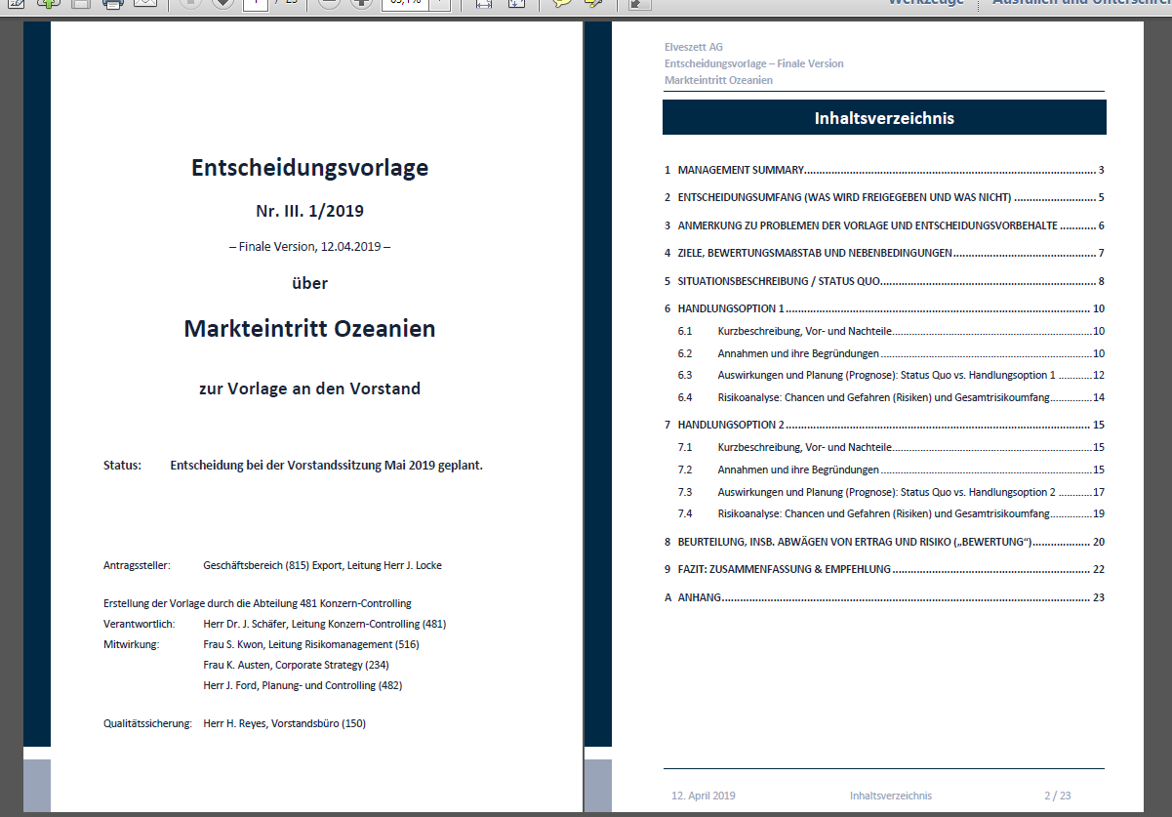

Management decisions under uncertainty:
Business Judgement Rule (Section 93 AktG, see DIIR RS No 2)
§ Section 93 AktG: "(1) The members of the Management Board must exercise the diligence of a prudent and conscientious manager in their management of the company. There is no breach of duty if the Management Board member could reasonably assume when making a business decision that they are acting for the benefit of the company on the basis of appropriate information."

Slide 75
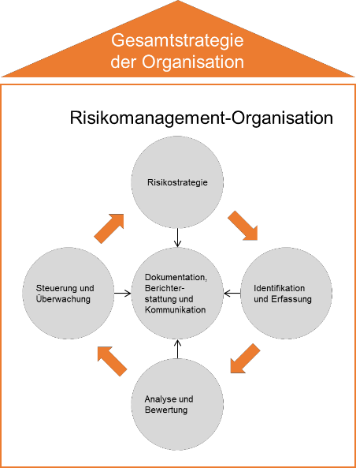
The new DIIR RS No 2.1 (2022) standard taking into account the implications of Section 93 AktG, StaRUG, FISG (unlike IDW PS 340 (2020))
- Independent consideration of two test tasks
The audit of organization and processes in risk management and
The audit of the business methods used in risk management (e.g. for risk quantification and risk aggregation), cf. section 91 AktG.
Risk as a possible deviation from plan (opportunity and danger)
Focus topics: Risk quantification, risk aggregation, risk-bearing capacity, decision orientation, risk culture, 3 lines of defense, risk management
"The method of risk aggregation, which ensures that the combined effects of individual risks are also recognized with regard to a resulting development that could endanger the company's continued existence, must be examined."
"Particular attention must be paid to strategic risks that threaten the key potential for success and which can generally only be analyzed with the involvement of the management. " (RZ 45)
"It is also one of the tasks of risk management to ensure that the implications of major business decisions for the future scope of risk are clearly identified as early as the preparation stage in order to at least recognize at an early stage any developments that may jeopardize the company's continued existence. " (margin no. 16; see also margin no. 25)
Phase model of risk management (from DIIR Auditing Standard No. 2, p. 11)

Slide 76
Significant aspects of DIIR Auditing Standard No. 2 (DIIR RS No. 2)
(1 of 2)
Risk is understood as an umbrella term for possible positive deviations (opportunities) and negative deviations (threats, risks in the narrower sense) (see RZ 15).
With reference to the legal requirement in Section 91 (2) AktG with regard to the identification of possible "developments that could jeopardize the continued existence of the company", the risk aggregation method becomes the central audit area, as this is the only way to ensure that possible developments that could jeopardize the continued existence of the company from the combined effects of individual risks are also recorded (see margin no. 19 and margin no. 58).
DIIR Auditing Standard No. 2 also emphasizes the need to quantify risks (in line with IDW PS 340) and recommends the measurement of risk-bearing capacity and risk tolerance based on this (as does IDW PS 981).
It is of fundamental importance that the implications of Section 93 AktG with regard to "decision-oriented risk management" are also taken into account when examining risk management. Accordingly, the tasks of risk management are clearly stated (see margin no. 16): "It is also one of the tasks of risk management to ensure that the implications of major entrepreneurial decisions for the future scope of risk are already comprehensibly identified during the preparation of such decisions, in order to at least recognize at an early stage any development that might jeopardize the continued existence of the company.
Source: Gleißner, W./Kimpel, R. (2019): Prüfung des Risikomanagements und der neue DIIR Revisionsstandard No 2, in: ZIR, No 4/2019, pp. 148-159.

Slide 77
Significant aspects of DIIR Auditing Standard No. 2 (DIIR RS No. 2)
(2 of 2)
DIIR Auditing Standard No. 2 also emphasizes the importance of risk culture and makes it the subject of the audit.
DIIR Auditing Standard No. 2 emphasizes the strategic focus of risk management, similar to the new version of COSO Enterprise Risk Management (ERM) from 2017 (see Hunziker, 2019). This means, for example, that strategic risks (as well as uncertain planning assumptions) must also be taken into account when identifying risks. RZ 45 reads: "Particular attention must be paid to strategic risks that threaten the main potential for success and that can generally only be analyzed with the involvement of management."
According to DIIR Audit Standard No. 2, all management systems, e.g. including controlling or quality management, must be included if they deal with opportunities and risks.
DIIR Auditing Standard No. 2 emphasizes the division of responsibilities between risk management and operational management. RZ 61 reads: "According to the three lines of defense model, risk monitoring tasks are the responsibility of both operational management (risk owner) and central monitoring functions (e.g. risk controlling or central risk management)."
DIIR Auditing Standard No. 2 clarifies that the main objective of risk reporting and communication is to ensure that decision-makers and supervisory bodies are informed promptly about the organization's risk situation.
Source: Gleißner, W./Kimpel, R. (2019): Prüfung des Risikomanagements und der neue DIIR Revisionsstandard No 2, in: ZIR, No 4/2019, pp. 148-159.​

Slide 78

Principles of proper planning (GOP): meaningful planning as the basis for decision-making—Update 2022 (Version 3.0)
  Requirements of the principles of proper planning (GOP)
    Operational planning must be derived from the strategy,
    Integration of the sub-plans.
    Transparency and clarity of terms, in particular
    "Planned values" (planning in line with expectations).
    Knowledge of opportunities and threats (risks),
    which can trigger deviations from the plan.
    Analysis of the scope of possible
    deviations from plan (aggregated scope of risk,
    e.g. expressed by the equity requirement).
    Assessment of the planning from the perspective of
    lenders (rating forecast) and
    Rating of adequate debt capital interest rates.
    Deviation analysis and feedback
Introduction
Target and strategy definition
Strategic planning
Operational planning
Revolving and comparisons
Legal basis and principles
Analysis
Corporate planning has to fulfill the following basic functions:
a) Decision preparation function: Corporate planning is the basis for management decisions, especially for the "entrepreneurial decisions" that can only be made by the management.
b) Crisis early warning function: Corporate planning, especially liquidity planning and risk analysis, are used for the early detection of crises, especially possible "developments that could jeopardize the company's continued existence" (Section 1 StaRUG).
Source: Gleißner, W./Presber, R. (2010): Die Grundsätze ordnungsgemäßer Planung – GOP 2.1 des BDU: Nutzen für die betriebswirtschaftliche Steuerung, in: Controller Magazin, No 6, pp. 82–86​

Slide 79
Appendix.
Legal and regulatory requirements, especially for Germany

Slide 80
The most important facts about risk management in 10 points (1 of 4)
Entrepreneurship is always associated with uncertainty, i.e. risks. If the future cannot be predicted with certainty, risks can lead to deviations from the plan. Risk is the generic term for opportunity and danger (i.e. possible positive and negative deviations from the plan). The ability to deal with uncertainty is of great importance for securing the continued existence and sustainable success of companies.
Particularly significant risks are "strategic risks" (especially threats to potential success), economic risks and uncertainties regarding key planning assumptions (e.g. regarding the development of demand, commodity prices or exchange rates). However, operational risks to service provision and "sustainability risks" must also be systematically analyzed.
As a cross-divisional function within the company, risk management deals with the systematic identification, quantification, aggregation, management (control) and monitoring of risks. The aim is to create transparency about the scope of risk, in particular in order to identify potential developments that could jeopardize the company's continued existence in good time. The need for risk coverage potential, i.e. equity and liquidity, is calculated as a function of the overall scope of risk. Economic added value is created in particular if the implications for expected future earnings on the one hand and risk and rating on the other are assessed when preparing business decisions.
Source: Gleißner, W. (2022): Fundamentals of Risk Management, 4th ed., Vahlen Verlag Munich, p. 680 ff.

Slide 81
The most important facts about risk management in 10 points (2 of 4)
The degree to which a company's existence is at risk in the future is expressed by the probability of risk and probability of insolvency or the future rating. The calculation of the implications of existing risks for the future rating, i.e. the assessment of a company from a creditor's perspective, is necessary in order to be able to assess developments that could jeopardize the company's continued existence. Risk management is therefore the basis for early crisis detection and crisis prevention, because crises are the result of risks that have occurred. Determining the probability of insolvency and danger depending on the scope of risk and the risk coverage potential (equity and liquidity resources) enables the timely initiation of "suitable countermeasures" to avert crises and safeguard the company as a going concern (Section 1 StaRUG).
All of the company's material risks should and can - assuming adequate expertise - be described using suitable probability distributions (e.g. by specifying the minimum value, most probable value and maximum value of a planning item).
As it is not normally individual risks but the combined effects of several risks that lead to crises and "developments that threaten the existence of the company" (as defined in Section 91 (2) AktG, Section 1 StaRUG), risk aggregation is the key technology in risk management. Risk aggregation determines the overall scope of risk by calculating a large representative number of risk-related possible future scenarios (Monte Carlo simulation). It thus combines traditional corporate planning with the company's risks and shows the "average" expected development of cash flow and profit as well as the planning reliability ("bandwidth planning").
Source: Gleißner, W. (2022): Fundamentals of Risk Management, 4th ed., Vahlen Verlag Munich, p. 680 ff.

Slide 82
The most important aspects of risk management in 10 points (3 of 4)
Weighing up expected returns and risks using a performance measure is possible using the key figure "enterprise value" (decision value). This can be calculated on the basis of the aggregated earnings risk using risk-adjusted capital costs and thus, for example, compare different strategic options ("strategy evaluation"). Risk analyses are therefore a necessary basis for value-oriented management because, due to capital market imperfections, it is not possible to draw conclusions about the company's future earnings risks relevant to valuation from "historical share return fluctuations" (beta factor of the CAPM). When preparing "entrepreneurial decisions" (Section 93 AktG), "decision-oriented risk management" provides neutral and well-founded risk analyses that show the change in a company's scope of risk and make it possible to weigh up risk and return through a risk-adequate valuation.
As far as possible, a company's risk management should use existing and proven management systems - such as controlling, quality management, treasury or project management - to fulfill its tasks and, often in conjunction with the further development of controlling, lead to an integrated "value-oriented corporate management approach" ("integrative risk management"). The aim is to enable company management to take better account of the uncertainties of an unpredictable future when making decisions (and thus promote the company's long-term success).
Source: Gleißner, W. (2022): Fundamentals of Risk Management, 4th ed., Vahlen Verlag Munich, p. 680 ff.

Slide 83
The most important aspects of risk management in 10 points (4 of 4)
In addition to a robust strategy and financial sustainability, the ability to deal with uncertainty (risks) is the third building block for securing the long-term success of a company ("robust company"). Risk management measures contribute to the optimization of the risk-return profile and must be assessed taking into account their costs and effects on the overall scope of risk (optimization of risk costs). A fundamental improvement in the risk-return profile usually requires a change in strategy on the way to becoming a "robust company". This avoids critical dependencies, has a high risk coverage potential, high flexibility and builds on core competencies that sustainably secure competitive advantages (pricing power) in as many attractive markets as possible.
If the future cannot be predicted with certainty, all employees - and in particular the company management - should view all management as risk management. Opportunities and threats, including those arising from the uncertain effects of the company's own activities and decisions, should also be adequately taken into account in normal day-to-day business ("embedded risk management"). This goes hand in hand with an integrative approach to strategic management that takes uncertainty into account and ensures and continuously improves the company's long-term survival and future viability.
Source: Gleißner, W. (2022): Fundamentals of Risk Management, 4th ed., Vahlen Verlag Munich, p. 680 ff.

Slide 84
Risk management as a crisis prevention system requires risk aggregation using Monte Carlo simulation
§
§
§
§ Section 91 para. 2 AktG: "The Management Board shall take appropriate measures, in particular to set up a monitoring system, to ensure that developments that could jeopardize the continued existence of the company are identified at an early stage."
...... supplemented by StaRUG (1.1.2021) .
"Section 1 Early crisis detection and crisis management for limited liability entities
(1) The members of the body appointed to manage a legal entity (managers) shall continuously monitor developments that could jeopardize the continued existence of the legal entity. If they recognize such developments, they shall take appropriate countermeasures and report immediately to the bodies appointed to supervise the management (supervisory bodies). ..."
§ Section 93 (2) AktG: "(1) The members of the Management Board must exercise the diligence of a prudent and conscientious manager in their management of the company. There is no breach of duty if the Management Board member could reasonably assume when making a business decision that they are acting for the benefit of the company on the basis of appropriate information.

Slide 85
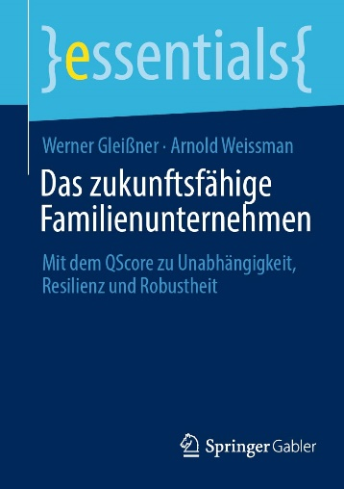
Books
Das zukunftsfähige Familienunternehmen – Mit dem QScore zu Unabhängigkeit, Resilienz und Robustheit (essentials)
Prof. Dr. Werner Gleißner / Prof. Dr. Arnold Weissman
75 pages, ISBN 978-3658427863, Publisher: Springer Gabler Wiesbaden, 2023, 14,99 €
The future viability of a company, i.e. its long-term survival with adequate success, requires financial sustainability (financial strength), a robust strategy and resilient performance as well as the ability to deal with opportunities and threats (uncertainty).
The QScore concept explained in the book shows, based on a large number of scientific studies, how the future viability of a company can be specifically assessed and potential for improvement derived.
The Essential explains how you can assess the future viability of a company in a simple "quick test" based on 20 questions.
The content
Safeguarding the future: the research situation
The QScore criteria Q1 to Q10
Sustainability, ESG and QScore
The analysis: the path to the QScore
The target groups: Entrepreneurs, managing directors, board members, supervisory board members, advisory board members, shareholders and successors
Specialists and managers from controlling, risk management and strategic corporate planning
This is an open access book, which means that you have free and unrestricted access to the eBook as a pdf.
https://link.springer.com/content/pdf/10.1007/978-3-658-42787-0.pdf
The authors
Prof. Dr. Werner Gleißner is CEO of FutureValue Group AG and honorary professor at the Technical University of Dresden (business administration, in particular risk management) as well as a board member of the European Association of Certified Valuators and Analysts (EACVA) and the German Society for Crisis Management (DGfK).
Prof. Dr. Arnold Weissman is an entrepreneur, owner of a knowledge platform for family businesses (ww.arnoldweissman.de), multi-supervisory board member, speaker and executive coach.

Slide 86
Further Literature (1 of 4)
Download via: www.werner-gleissner.de or www.FutureValue.de
For general methodological explanations, we recommend the following specialist articles:
Berger, Th./Kamaras, E. (2020): Ableitung eines Ratings mit Hilfe der Risikoaggregation – Ein Fallbeispiel, in: Controller Magazin, No 5, September/Oktober 2020,
pp. 29–34.
Berger, Th./Ernst, D./Gleißner, W./Hofmann, K. H./Meyer, M./Schneck, O./Ulrich, P./Vanini, U. (2021): Die Prüfung von Risikomanagementsystemen und die Defizite des IDW Prüfungsstandards 340, in: Der Betrieb, 74. Vol., No 46, pp. 2709-2714.
DIIR- und RMA-Arbeitskreis „Interne Revision und Risikomanagement“ (2022): Der neue DIIR Revisionsstandard Nr. 2 zur Prüfung des Risikomanagementsystems. Implikationen von FISG und StaRUG für die Interne Revision, erarbeitet von Bünis, M./Disch, O./Gleißner, W./Gutzmer, M./Hadaschik, M./Kempf, A./Kimpel, R., in: ZIR,
No 3, pp. 112–117.
Dorfleitner, G./Gleißner, W. (2018): Valuing streams of risky cashflows with risk-value models, in: Journal of Risk, Vol. 20, No. 3 (February 2018), pp. 1–27.
Exler, M./Gleißner, W./Obersteiner, R./Presber, R./Redley, R./Henning, W./Weyrather, Ch. (2023): Die neuen Grundsätze ordnungsgemäßer Planung. In der neuen Version GoP 3.0 von 2022, in: Controller Magazin, No 1 (Januar/Februar 2023), pp. 74–78.
Franken, L./Gleißner, W./Schulte, J. (2020): Insolvenzrisiko und Berücksichtigung des Verschuldungsgrads bei der Bewertung von Unternehmen – Stand der Diskussion nach Veröffentlichung des IDW Praxishinweises 2/2018, in: Corporate Finance, No 03-04 vom 30.03.2020, pp. 84–96.
Gleißner, W. (2000): Risikopolitik und Strategische Unternehmensführung, in: Der Betrieb, 33/2000, pp. 1625–1629.
Gleißner, W. (2005): Kapitalkosten: Der Schwachpunkt bei der Unternehmensbewertung und im wertorientierten Management, in: Finanz Betrieb, 4/2005, pp. 217–229.
Gleißner, W. (2011): Wertorientierte Unternehmensführung und risikogerechte Kapitalkosten: Risikoanalyse statt Kapitalmarktdaten als Informationsgrundlage, in: Controlling, 3/2011, pp. 165–171.
Gleißner, W. (2011): Risikoanalyse und Replikation für Unternehmensbewertung und wertorientierte Unternehmenssteuerung, in: WiSt, No 7/11, pp. 345–352.
Gleißner, W. (2013): Die risikogerechte Bewertung alternativer Unternehmensstrategien: ein Fallbeispiel jenseits CAPM, in: BewertungsPraktiker 3/2013, pp. 82–89.
Gleißner, W. (2014): Kapitalmarktorientierte Unternehmensbewertung: Erkenntnisse der empirischen Kapitalmarktforschung und alternative Bewertungsmethoden, in: Corprate Finance 4/2014, pp. 151–167.
Gleißner, W. (2015): Börsenkurs und "wahrer Wert" in Abfindungsfällen – Aktien- versus Unternehmensbewertung, Anwendbarkeit des CAPM und Ertragsrisiko, in: WPg – die Wirtschaftsprüfung, 2 / 2015, pp. 72–80
Gleißner, W. (2015): Controlling und Risikoanalyse bei der Vorbereitung von Top-Management-Entscheidungen – Von der Optimierung der Risikobewältigungsmaßnahmen zur Beurteilung des Ertrag-Risiko-Profils aller Maßnahmen, in: Controller Magazin, 4/2015, pp. 4–12
Gleißner, W. (2015): Ermittlung eines objektivierten Unternehmenswerts von KMU – Anregungen unter besonderer Berücksichtigung von Rating und Insolvenzwahrscheinlichkeit, in: WPg, 17/2015, pp. 908–919.
Gleißner, W. (2017): Controlling und Risikoanalyse bei der Vorbereitung von Top-Management-Entscheidungen, in: Gleißner, W./Klein, A. (2017): Risikomanagement und Controlling, 2. Aufl., Haufe-Lexware, Munich 2017, pp. 129–151.

Slide 87
Further Literature (2 of 4)
Download via: www.werner-gleissner.de or www.FutureValue.de
Gleißner, W. (2017): Risikoanalyse, Risikoquantifizierung und Risikoaggregation, in: WiSt, No 9, 2017, pp. 4–11.
Gleißner, W. (2018): Risikomanagement 20 Jahre nach KonTraG: Auf dem Weg zum entscheidungsorientierten Risikomanagement, in: Der Betrieb vom 16.11.2018,
No 46, pp. 2769–2774.
Gleißner, W. (2019): Cost of capital and probability of default in value-based risk management, in: Management Research Review (MRR), Vol. 42, No. 11, pp. 1243–1258.
Gleißner, W. (2019): Risikoanalyse: Ein strukturierter Leitfaden zur Risikoquantifizierung (Teil 2), in: Controller Magazin, No 3, Mai/Juni 2019, pp. 31–35.
Gleißner, W. (2019): The real dark side of Valuation. Ertragsrisiken und Insolvenzrisiken, in: BOARD, No 6/2019, pp. 215–219.
Gleißner, W. (2020): Risikoanalyse und moderne Unternehmensbewertungsverfahren als Alternative zum CAPM, in: Controlling, 32. Vol., No 1/2020, pp. 35–37.
Gleißner, W. (2020): Editorial: Controlling und Risikomanagement in der Corona-Krise: Lessons Learned (oder noch nicht?), in: Controller Magazin, No 4, pp. 101–102.
Gleißner, W. (2020): Unternehmensstrategie und strategische Positionierung im Zeitalter der Digitalisierung, in: Controller Magazin, No 1/2020, pp. 4–13.
Gleißner, W. (2020): Integratives Risikomanagement. Schnittstellen zu Controlling, Compliance und Interner Revision, in: Controlling, 32. Vol., No 4, pp. 23–29.
Gleißner, W. (2020): Risikomanagement: Gegenwart und Zukunft, in: REthinking Finance, No 4 (August 2020), pp. 24–28.
Gleißner, W. (2020): Lessons learned der Corona-Krise. Schwarze Schwäne, Resilienz und robuste Unternehmen, in: CFO aktuell, 14. Vol., No 6, pp. 234–238.
Gleißner, W. (2020): Risikoblindheit. Facetten, Ursachen, Auswirkungen und Gegenmaßnahmen, in: Zeitschrift für Risikomanagement (ZfRM), 1. Vol., No 1.20, pp. 10–14.
Gleißner, W. (2021): Unternehmerische Entscheidungen. Haftungsrisiken vermeiden (§ 93 AktG, Business Judgement Rule), in: Controller Magazin, No 1, pp. 16–23.
Gleißner, W. (2021): Krisenfrüherkennung und Kennzahlen einer Krisenampel. Implikationen aus dem StaRUG (2021), in: Controller Magazin, No 5, pp. 34–42.
Gleißner, W. (2021): Strategisches Management unter Unsicherheit: Das robuste Unternehmen, in: REthinking Finance, No 1 (Februar 2021), pp. 33–41.
Gleißner, W. (2022): Grundlagen des Risikomanagements. Handbuch für ein Management unter Unsicherheit, 4th ed., Vahlen Verlag Munich.
Gleißner, W. (2023): Nachhaltigkeit ist mehr als ein guter ESG-Score, in: ESGZ, No 1.2023, pp. 43–47.
Gleißner, W. (2023): Finanzwirtschaft und Risiko – Finanzierung, Kapitalkostenberechnung und Investitionsbewertung mit Methoden des Risikomanagements, in: BFuP, 75. Vol., No 5, pp. 598–619.

Slide 88
Further Literature (3 of 4)
Download via: www.werner-gleissner.de or www.FutureValue.de
Gleißner, W. (2023): Missverständnisse im Zusammenhang mit dem Risikomanagement, in: Zeitschrift für Bilanzierung, Rechnungswesen und Controlling (BC),
No 2/2023, pp. 84–87.
Gleißner, W. (2023): Uncertainty and resilience in strategic management: profile of a robust company, in: International Journal of Risk Assessment and Management (IJRAM), Vol. 26, No. 1, pp. 75–94, https://dx.doi.org/10.1504/IJRAM.2023.132331.
Gleißner, W. (2024):Nachhaltigkeit und ESG: Vorsicht bei der Umsetzung der Corporate Sustainability Reporting Directive (CSRD), in: Rethinking Finance, 7. Vol., No 1, pp. 26–32.
Gleißner, W./Ernst, D. (2019): Company valuation as result of risk analysis: replication approach as an alternative to the CAPM, in: Business Valuation OIV Journal, Vol. 1, No. 1 (Frühjahr 2019), pp. 3–18.
Gleißner, W./Follert, F. (2022): Unternehmensbewertung im Spannungsfeld zwischen Zweckadäquanz und Praktikabilität. Ein Lösungsansatz für die gerichtliche Abfindungsbemessung, in: BFuP, 74. Vol., No 4, pp. 395–419.
Gleißner, W./Günther, Th./Walkshäusl, Ch. (2022): Financial sustainability: measurement and empirical evidence, in: Journal of Business Economics, 92, pp. 467–516, https://doi.org/10.1007/s11573-022-01081-0.
Gleißner, W./Kalwait, R. (2010): Integration von Risikomanagement und Controlling – Plädoyer für einen völlig neuen Umgang mit Planungssicherheit im Controlling, in: Controller Magazin, Ausgabe 4, Juli/August 2010, pp. 23–34.
Gleißner, W./Kamaras, E./Wolfrum, M. (2023): Risikotragfähigkeit eines Unternehmens. Messung nach § 1 StaRUG und Anforderungen an eine Risikomanagementsoftware, in: ZfRM, No 5.23, pp. 116–120.
Gleißner, W./Kimpel, R. (2019): Prüfung des Risikomanagements und der neue DIIR Revisionsstandard Nr. 2, in: ZIR, No 4/2019, pp. 148–159.
Gleißner, W./Moecke, Ph./Weissman, A. (2023): Umfassendes Nachhaltigkeitsmanagement. Der QScore als bessere Alternative zu einem ESG-Score, in: Zeitschrift für Familienunternehmen und Strategie (FuS), 13. Vol., No 5, pp. 191–198.
Gleißner, W./Nickert, A./Nickert, C. (2023): Die Auswirkungen des § 1 StaRUG auf die Aktiengesellschaft, in: Der Betrieb, No 26, pp. 1489–1498.
Gleißner, W./Weissman, A. (2024): Das zukunftsfähige Familienunternehmen. Mit dem QScore zu Unabhängigkeit, Resilienz und Robustheit, essentials, Springer Gabler Wiesbaden, https://link.springer.com/book/10.1007/978-3-658-42787-0.
Gleißner, W./Wolfrum, M. (2017): Risikotragfähigkeit, Risikotoleranz, Risikoappetit und Risikodeckungspotenzial, in: Controller Magazin, November / Dezember 2017,
pp. 77–84.
Günther, Th./Gleißner, W. (2021): Entscheidungsvorlagen für die Unternehmensführung, in: Controlling, Vol. 33, No 6, pp. 44–46.
Kamarás, E./Wolfrum, M. (2017): Software für Risikoaggregation: Gängige Lösungen und Fallbeispiel, in: Gleißner, W. / Klein, A. (2017): Risikomanagement und Controlling, 2. Aufl., Haufe-Lexware, Munich 2017, pp. 289–314.
Pedell, B./Gleißner, W./Kühlem, Ch./Nickel, J. (2024): Resilienz- und Risikomanagement in der Wertschöpfungskette, in: Controlling & Management Review, 68. Vol.,
No 1, pp. 8–16.

Slide 89
Further Literature (4 of 4)
Download via: www.werner-gleissner.de or www.FutureValue.de
Risk Management Association e. V. (RMA) (Hrsg.): Managemententscheidungen unter Risiko, erarbeitet von Werner Gleißner, Ralf Kimpel, Matthias Kühne, Frank Lienhard, Anne-Gret Nickert und Cornelius Nickert, Erich Schmidt Verlag Berlin, 2019.
Romeike, F./Hager, P. (2020): Erfolgsfaktor Risiko-Management 4.0. Methoden, Beispiele, Checklisten Praxishandbuch für Industrie und Handel, Springer Gabler, Wiesbaden.
Spremann, K. (2004): Valuation: Grundlagen moderner Unternehmensbewertung, Oldenbourg Wissenschaftsverlag, 2004.
Velte, P./Eulerich, M. (2021): Das geplante Finanzmarktintegritätsstärkungsgesetz (FISG). Eine kritische Diskussion aus Sicht der Internen Revision, in: Zeitschrift Interne Revision (ZIR), 56. Vol., No 2/2021, pp. 64–69.
Vanini, U./Rieg, R. (2021): Risikomanagement: Grundlagen – Instrumente – Unternehmenspraxis, 2. Aufl., Schäffer Poeschel, Stuttgart.
Walkshäusl, C. (2013): Fundamentalrisiken und Aktienrenditen: Auch hier gilt, mit weniger Risiko zu einer besseren Performance, in : CFB vom 08.04.2013, No 03,
pp. 119–123.
Baumüller, J./Gleißner, W. (2020): Quantifizierung von nichtfinanziellen Risiken im unternehmensweiten Risikomanagement, in: GRC aktuell, 3. Vol., No 4/2020,
pp. 139–147.
Gleißner, W./Weissman, A. (2023): Das Paradigma der Wertorientierung: Der Weg zur Zukunftsfähigkeit, in: Board, No 6/2023, pp. 223–227.
Gleißner, W./Berger, Th. (2024): Enterprise Risk Management, in: Risks 12(12), 196, https://doi.org/10.3390/risks12120196, Download unter: https://www.mdpi.com/2227-9091/12/12/196/pdf.
Gleißner, W. (2023): Uncertainty and resilience in strategic management: profile of a robust company, in: International Journal of Risk Assessment and Management (IJRAM), Vol. 26, No. 1, pp.75-94, https://dx.doi.org/10.1504/IJRAM.2023.132331.
Gleißner, W./Haarmeyer, H. (2024): StaRUG: Auswirkungen auf Risikomanagement und den Weg zu Restrukturierung & Sanierung, in: ZInsO, 27. Vol., No 5,
pp. 173–177.
Rieg, R./Vanini, U./Gleißner, W. (2025): Enterprise Risk Management. A Modern Approach, Springer (im Erscheinen).
Gleißner, W./Baumüller, J. (2024): Doppelte Wesentlichkeit gem. CSRD und Nachhaltigkeitsrisiken – Ein Vorschlag für eine Operationalisierung samt Integration in das Risikomanagement, in: KoR, No 05, pp. 202–209.
Gleißner, W./Ernst, D. (2024): Neue Wege der Unternehmensbewertung – Der BGH-Beschluss zur Bestimmung der angemessenen Abfindung und seine Auswirkungen, in: BFuP, 76. Vol. (2024), No 4, pp. 414–431.
Ernst, D./Gleißner, W. (2022): Paradigm Shift in Finance: The Transformation of the Theory from Perfect to Imperfect Capital Markets Using the Example of Company Valuation, in: Journal of Risk and Financial Management, Vol. 15, No. 9, pp. 399 ff., Download unter: https://www.mdpi.com/1911-8074/15/9/399/pdf?version=1662641741.
Gleißner, W./Ernst, D. (2023): The Simulation‐Based Valuation of Companies and Their Strategies – Classification, Methodology and Case Study, in: EBVM – The European Business Valuation Magazine, Vol. 2, No. 2, pp. 4–16.

